Slide 1
OPERATION CRYPTOSWEEP
May 21, 2018
Notes:
Session #1 Welcome Remarks

Slide 2
RESULTS
44 Jurisdictions Participating from U.S. and Canada
70+ Inquiries/Investigations (plus many more ongoing)
35 Pending/Completed Enforcement Actions (more expected from ongoing investigations)
OPERATION CRYPTOSWEEP
Notes:
Session #1 Welcome Remarks

Slide 3
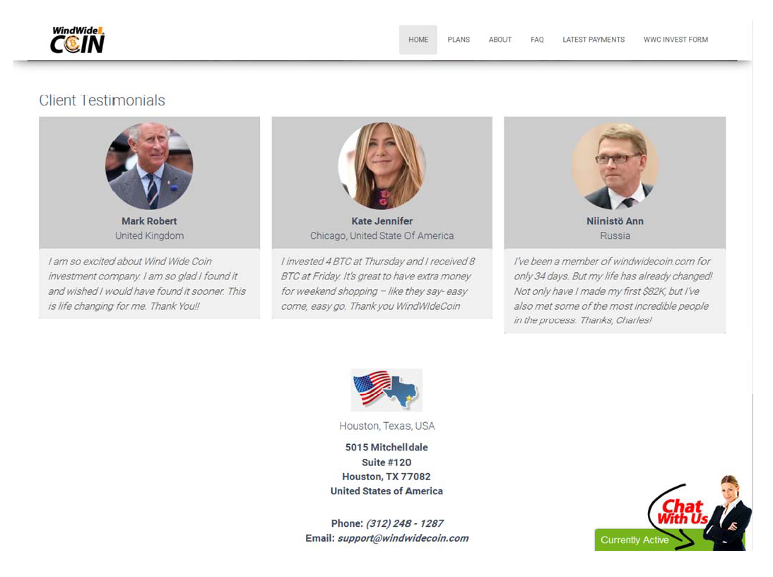
OPERATION CRYPTOSWEEP
Wind Wide Coin Screenshot featuring images of Prince Charles, Jennifer Aniston and former Finland Prime Minister Matti Vanhanen, courtesy of the Texas State Securities Board
Notes:
Session #1 Welcome Remarks

Slide 4
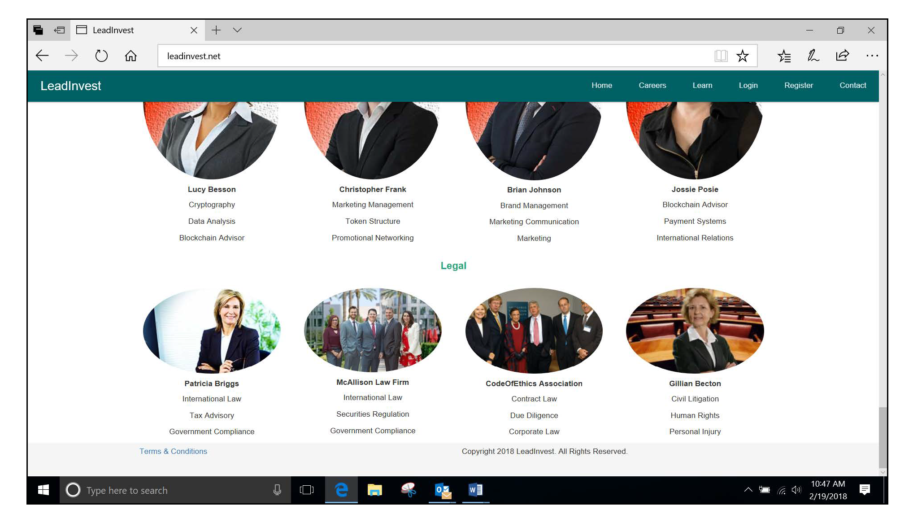
OPERATION CRYPTOSWEEP
LeadInvest Screenshot courtesy of the Texas State Securities Board
Notes:
Session #1 Welcome Remarks

Slide 5
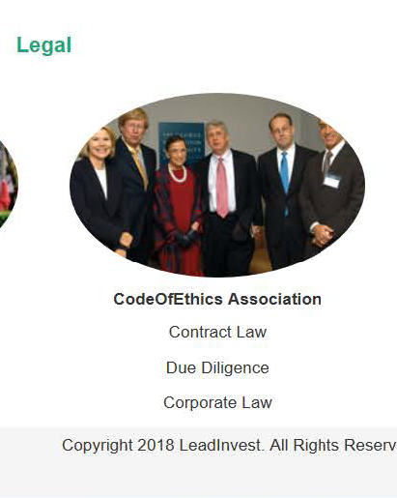
The photo of LeadInvest’s legal team’s “CodeOfEthics Association” [sic] is in reality a photo taken from the Fall, 2005 edition of The George Washington Law Review.
The photo shows participants in a Solicitor General panel discussion at the law school, including former Solicitor General Theodore Olson and current Supreme Court Associate Justice Ruth Bader Ginsburg.
OPERATION CRYPTOSWEEP
LeadInvest Screenshot courtesy of the Texas State Securities Board
Notes:
Session #1 Welcome Remarks

Slide 6
The photo of LeadInvest’s legal team’s “CodeOfEthics Association” [sic] is in reality a photo taken from the Fall, 2005 edition of The George Washington Law Review.
The photo shows participants in a Solicitor General panel discussion at the law school, including former Solicitor General Theodore Olson and current Supreme Court Associate Justice Ruth Bader Ginsburg.
OPERATION CRYPTOSWEEP
LeadInvest Screenshot courtesy of the Texas State Securities Board
Notes:
Session #1 Welcome Remarks

Slide 7
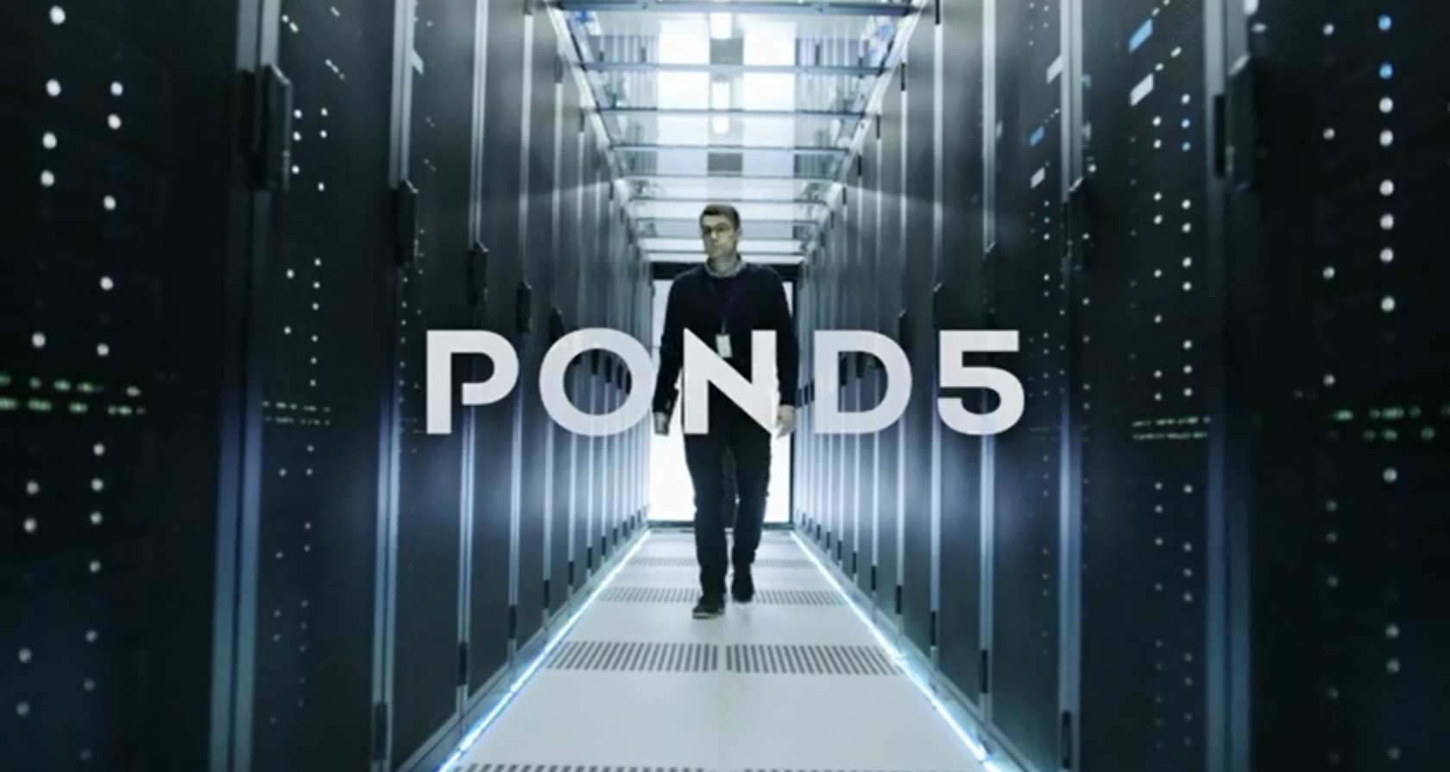
Video from BTCrush website.
OPERATION CRYPTOSWEEP
Stock footage
BTCrush Screenshot & stock footage screenshot courtesy of the Texas State Securities Board
Notes:
Session #1 Welcome Remarks

Slide 8
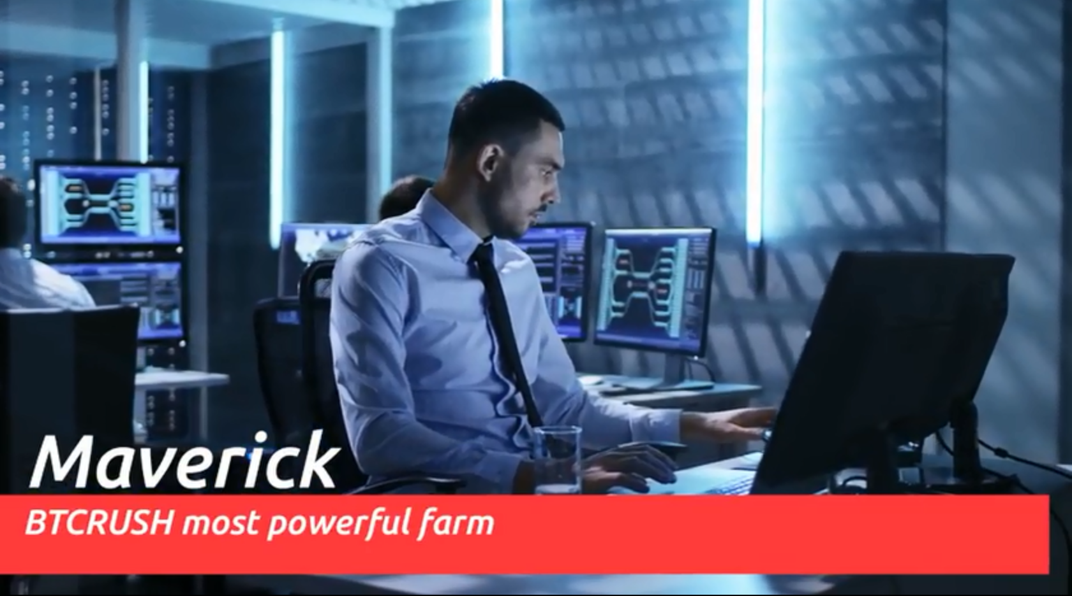
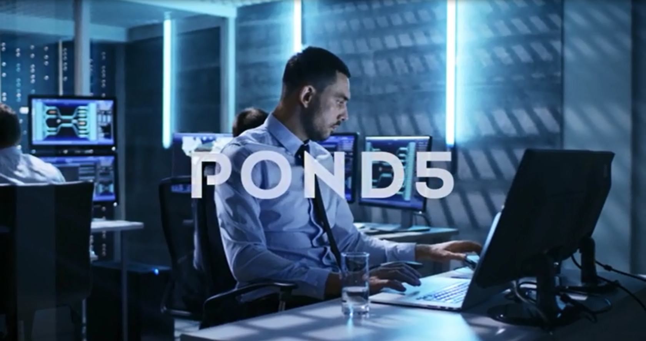
Video from BTCrush website.
OPERATION CRYPTOSWEEP
Stock footage
BTCrush Screenshot & stock footage screenshot courtesy of the Texas State Securities Board
Notes:
Session #1 Welcome Remarks

