Slide 1
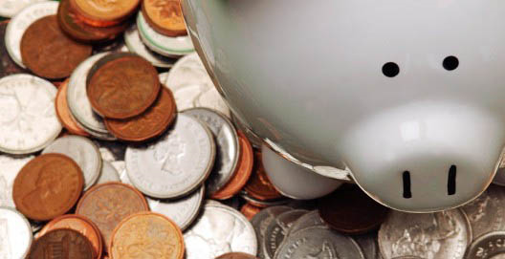

Making Money Makes $ense

Slide 2
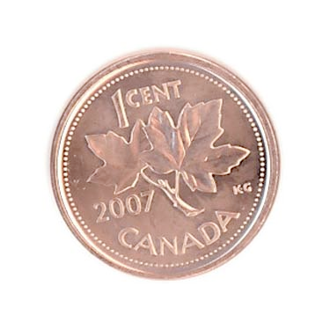
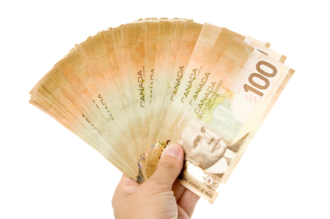
What would you Rather have?
Notes:
Day 29: worth 5 million 3hundred and 68 thousand 7 hundred and 9 dollars and 12 cents
Day 30: worth over 10 million
Instant gratification – I want it now – much more exciting than delaying it.
Now, saving is not DENYING it, it’s prioritizing and making it possible to have what you want without putting yourself in harm.

Slide 3
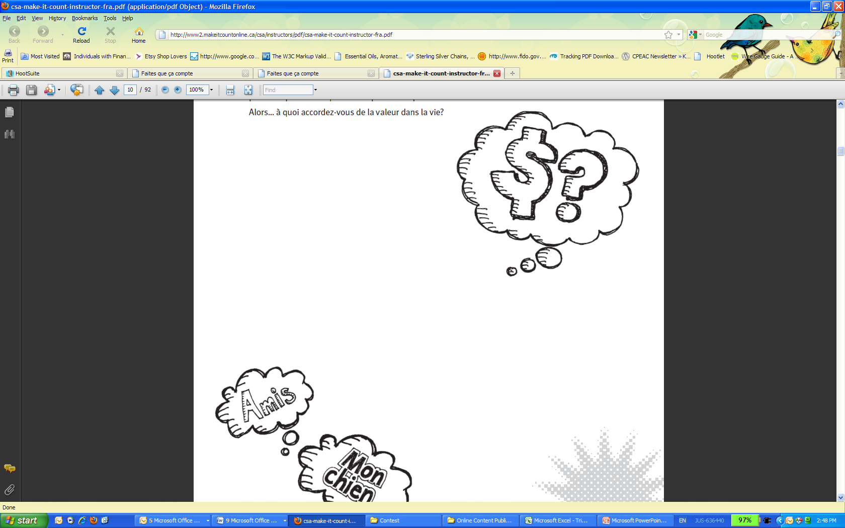
Does Money Have Value?
Notes:
Money doesn't have any inherent value. It is simply pieces of paper.
In the past money was in the form of coins, generally composed of precious metals such as gold and silver. The value of the coins was roughly based on the value of the metals they contained, because you could always melt the coins down and use the metal for other purposes.
Until a few decades ago paper money in different countries was based on the gold standard or silver standard or some combination of the two. This meant that you could take some paper money to the government, who would exchange it for some gold or some silver based on an exchange rate set by the government.
Now the United States is on a system of fiat money, which is not tied to any other commodity. So these pieces of paper in your pocket are nothing but pieces of paper. In other words, the value of money is now determined by your perception, impression or confidence on it.
As long as WE THINK, money is worth something, the money will be worth that much. Of course, the “WE” here is not you and me but “EVERYONE” in the globe.

Slide 4
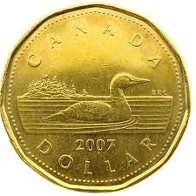
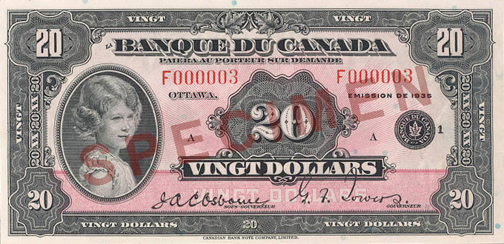
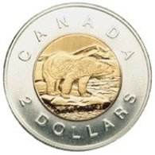
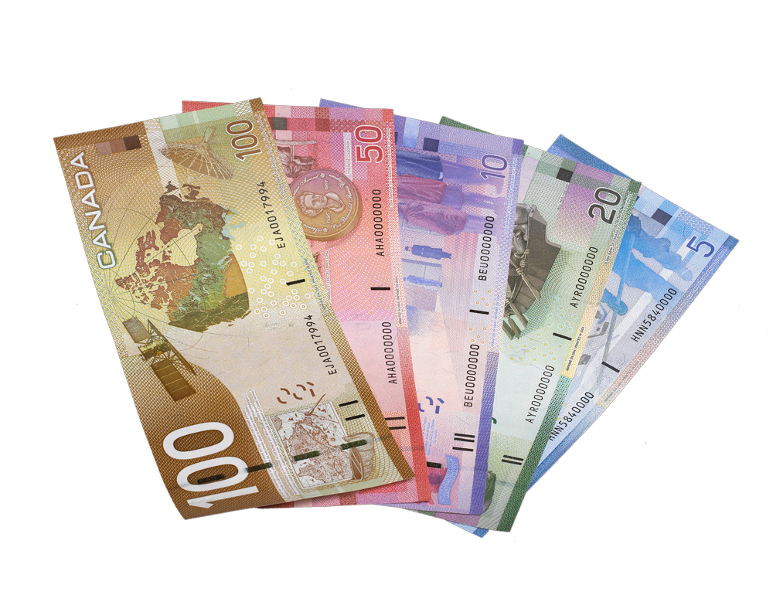
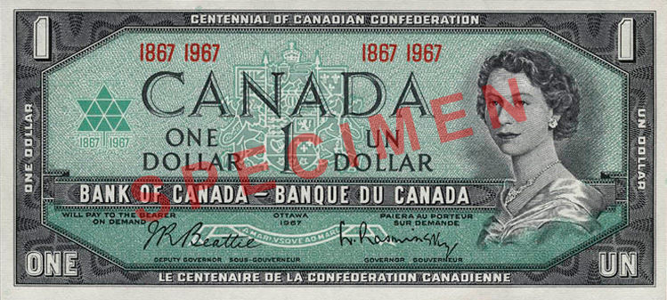
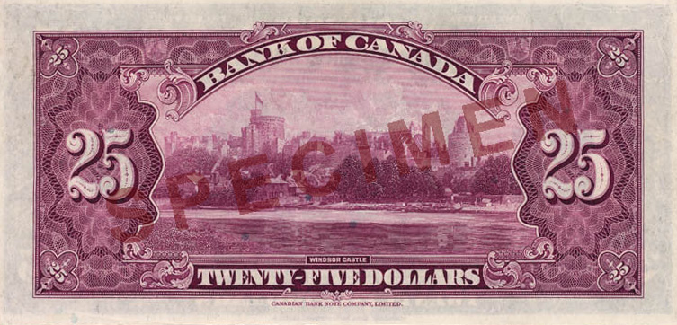
Did Money ALWAYS exist?
Notes:
Loonie – 1987
Toonie - 1996

Slide 5
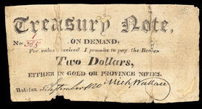
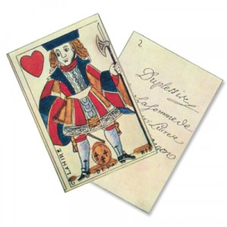
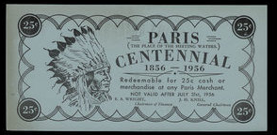
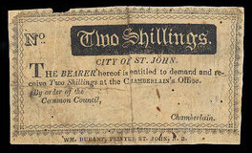
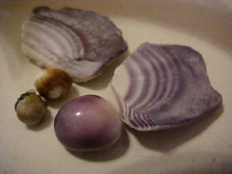
Did Money always exist?
Notes:
It didn't always work this way. Throughout Canada's history, many articles have been used as currency, including shells, glass beads, and animal furs. Even pieces of playing cards were legal tender in New France, when hard currency was scarce.
Banks were established in Canada in the early 1800s, and they issued their own notes, as did various governments and even merchants. It wasn’t until after Confederation in 1867, Parliament confirmed its control of currency with legislation and began to issue Dominion of Canada notes.

Slide 6
Other Forms of Money
 | Advantage | Disadvantage
Debit | • No need to carry large amounts of cash. • Can only spend what you have. | • Service charges. • Presents a security risk.
Notes:
How Do Debit Cards Work?
You present your debit card to the cashier.
The merchants scans your card into a device that
electronically checks if you have money in your account.
The money is transferred electronically from your account.

Slide 7
Other forms of Money
 | Advantage | Disadvantage
Credit | • Good for emergencies when you don’t have enough money. • Can be used for identification, phone or Internet orders and internationally. | • Can easily get into debt by spending more than you are able to pay back. • Service fees. • Presents a security risk.
Notes:
How Do Credit Cards Work?
You present your credit card to the cashier.
The merchant gets electronic authorization for the
purchase and imprints your card on a purchase statement.
You sign the statement of purchase
and receive a copy as a receipt.
Your financial institution sends you an invoice
or statement listing your purchases, the amount
owed, and the due date.
You pay your financial institution.

Slide 8
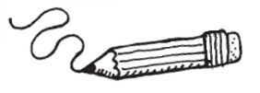
Money
What does money mean to you?
What are needs and wants?
What do you value?
Notes:
Before you can understand what money management means, it’s important to think about your values. What is important to you in your life? How can we understand how to manage our money if we don’t know what we want it to help us do?
What do you value? Family? Love? Friends? Health? How does money relate to this?
You might be surprised to know that « stuff » isn’t necessarily something that most people value. And what you spend your money on may not matter as much as you first thought. So…what do you value in life?
Your needs are things you have to buy to live day-to-day. These could be school supplies, clothes, shoes, transportation. Your wants are things that you’d like to have, but that aren’t necessary to survive day-to-day. What are some examples of your needs and wants?
One way to make sure that you don’t spend your money and have none left over for your needs, is to classify your spending as needs or wants, and then to put enough aside to cover your needs. Save as much as you can, and make smart decisions when purchasing « wants ». Pay yourself first, and that will help you to build weath, avoid spending too much, and not being able to cover your needs.
TRIVIA: What colour is the Canadian 10 dollar bill?

Slide 9
Before You Buy, ask yourself:
Do I NEED it?
Why do I want it?
What else do I want?
Is there an alternative to buying it?
Notes:
Whenever you spend money, you are making a decision, even if it is a small one. Before you take out your wallet,
remember to ask yourself the following questions:

Slide 10
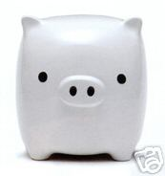
Where did all my money go?!
What do you spend your money on in a normal day? (Lunch? Snacks? Shopping? Music?)
What income did you receive? (Allowance? Pay cheque? Odd jobs? Babysitting? Gifts?)
What are some ways you can think of to spend less?
If you did that, how much money would you have available to save?
Notes:
The Specialty Coffee Association of America, which watches consumer spending of high quality coffee says that Americans spent $12 billion in 2006.
How much you set aside for savings will depend upon how eager you are to build wealth.
The idea of setting aside an amount for your savings before you spend on your wants is called the pay-yourself-first principle.
10%

Slide 11
Manage Your Money
Budgets help you balance your spending and saving.
Budgets help you spot where you may be over spending and where you can save more.
If you have a plan to follow each month, you are more likely to reach your goals.
What do you think happens to money that is invested wisely year after year after year?
Notes:
If you have some money left over in your budget after you have paid the bills, start saving it.
You will have the fun of deciding how to use your savings to achieve your goals. That’s the power of a budget.
Start with a basic plan and then adjust it to fit your special situation.
If your income changes a lot, expect your budget to vary throughout the year.
TRIVIA: If you had a million dollars and spent $1 every minute of every day, how long would it would take you to spend it all. (695 days / 1.78 yrs)

Slide 12
Setting Goals
What is a goal?
Setting goals
  What do you want to accomplish?
  When do you want to accomplish it? (Short term or long term?)
  How much money will it take?
Notes:
Is anyone saving their money for something in particular? If so, how are they saving?
The key to being successful at saving is to plan carefully. Be realistic, establish time frames, devise a plan, and be flexible as your goals may change.
Some of your goals may be short-term, or something you can accomplish fairly quickly. Others may be classified as long-term goals that will take more time to achieve.
For example, a short-term goal may be to save $3 000 in three years for a new computer system; a long-term goal may be to save $10,000 for college or university.
Write down your short and long-term goals and when you would like to achieve them. Once you know your goals, you can begin to save to achieve those goals. Tips to help you be systematic about saving are save every month, and have your savings automatically deducted from your paycheque or bank account.

Slide 13
Want to learn more?
www.makeitcountonline.ca
www.InvestInKnowingMore.ca
Follow us @NBSecuritiesCom

