Slide 1
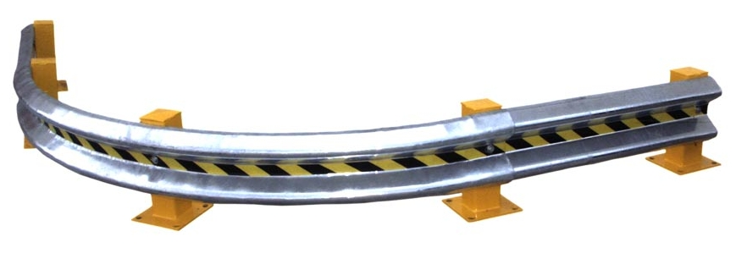
Guard Rails
Protecting Your Community
From
Investment Fraud
Presented by
By Nancy Boudreaux
Investor Education Trainer
Louisiana Office of Financial Institutions

Slide 2
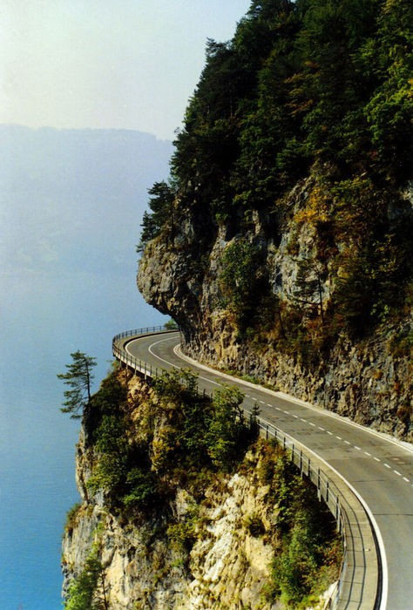
3
A system designed to
keep vehicles from straying
into dangerous areas
An Action Plan designed to
keep investors from straying
into dangerous areas
Notes:
1 Tech definition
2 – New Definition
Definition of a “guard rail”, then re-define that definition for investors

Slide 3
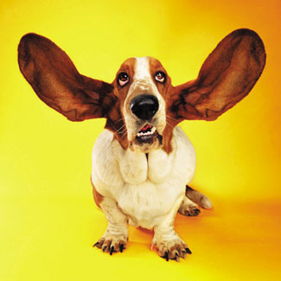
Why listen?

Slide 4
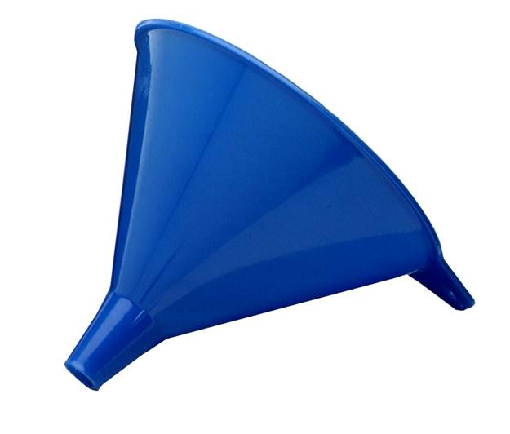
Investor Education
FBI
CFPB
AARP
NASAA
FINRA
IPT
“Main Street” Investors
Notes:
NOT to “Wall Street” investors

Slide 5
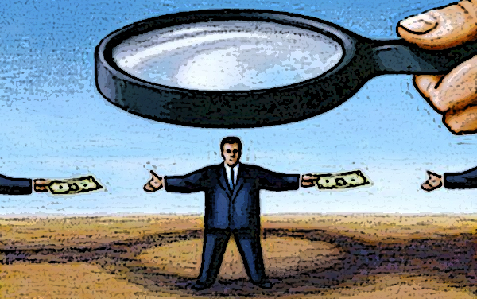
Regulation
State Securities Regulator
Investigation
Investment Professional
Notes:
Exemptions

Slide 6
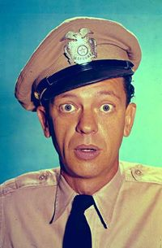

Wake up!
Notes:
1st Guard Rail
Standard of behavior

Slide 7

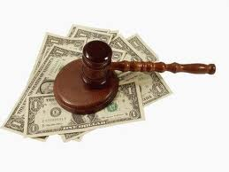

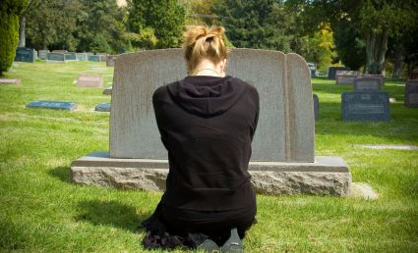
55+
Notes:
Over 55 (Baby Boomers)
Expecting a cash settlement
Getting divorced
Recent death of a loved one
How many of you know someone who is…..

Slide 8
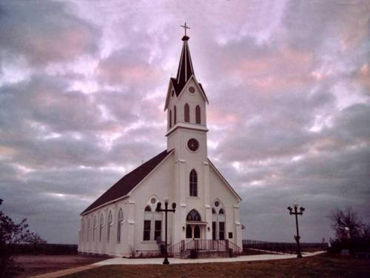

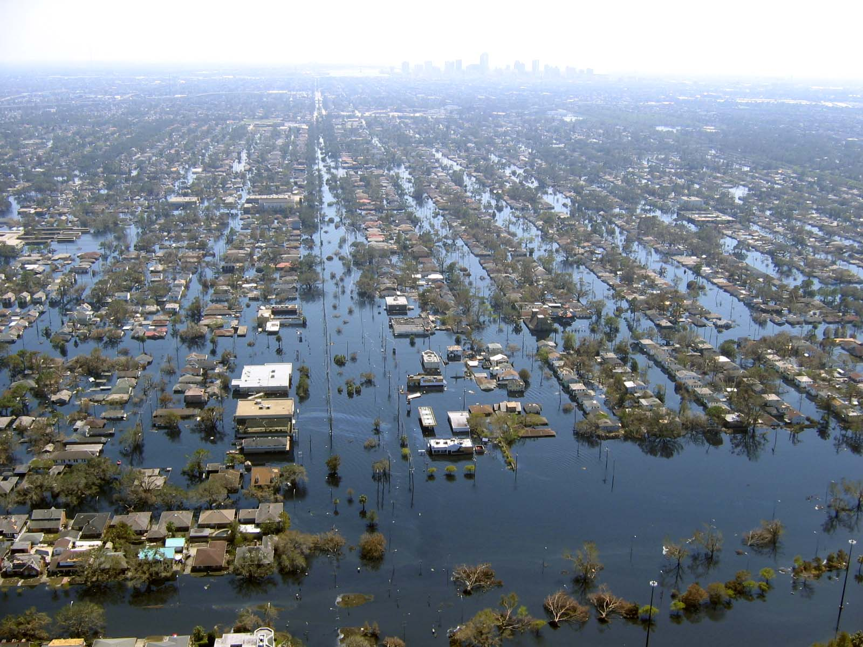
Notes:
Active member of a church or social club
7/2006 FINRA Inv. Ed Foundation survey among fraud victims:
Of those introduced to financial professional through friend or family
60% hired financial professional based on recommendation from family & friends; 70% bought investments
Scams flourish after a natural disaster or world emergency

Slide 9
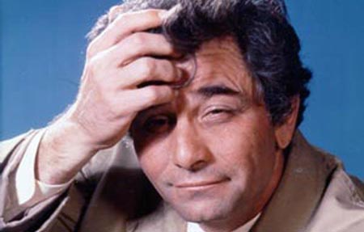
Wise up!

Slide 10

The “holy trinity” of Investing
High profit
Liquid
Low risk

Slide 11
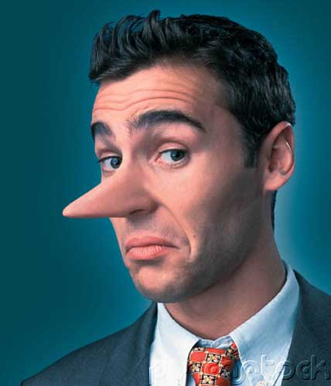

Crimes of Persuasion
Hopes & Fears
Tricks of the Trade: Outsmarting Investment Fraud DVD
Joint venture of FINRA, AARP andwww.saveandinvest.org
Weapons of Fraud by Anthony Pratkanis & Doug Shadel
Notes:
3

Slide 12

M C
I
ild
ognitive
mpairment
Made 4 times more mistakes in financial decisions
*Elder Financial Fraud: A National Epidemic DVD by North
American Securities Administrators Association (NASAA), Investor Protection Trust
(IPT) and Investor Protection Institute

Slide 13
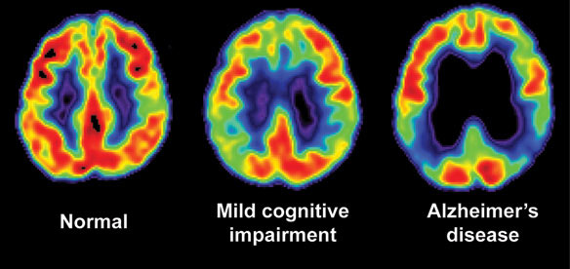
Memory, subtle language difficulties, ability to multi-task
BUT
General cognitive functions
Vocabulary
General knowledge
ADLs (bathing, eating, cooking)
NOT demented

Slide 14
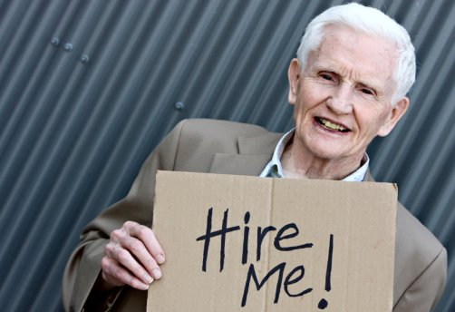
Indicators
Of
MCI
Socially isolated
Made poor investments
Changed his/her will
Reduced ability to make decisions
More willing to “gamble” with their money

Slide 15

Cognitive “Reserve”
Protection against age-related brain changes
*Increases Reserve
Higher levels of education
Exercise
Mediterranean-style diet
Complex job
Bilingual
Large social network
*Reduces Reserve
Prior head injury
Diabetes
High blood pressure
High cholesterol
*Coping With Mild Cognitive Impairment - NYTimes.com 11/27/12

Slide 16
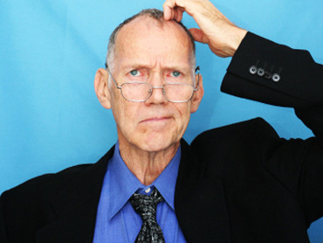
For loved ones with MCI
Sign them up for the DO NOT CALL list
Get the deal in writing
Get copies of anything they sign
Check the registration status of the product and the promoter before investing
Request and read CRD Reports before investing
Use the Investor Checklist form for new investments
Report suspicions of fraud
Stay current on fraudulent scams at http://www.nasaa.org/investor-education/
Use NASAA’s Conversation Starter for Empty Nesters at
http://www.nasaa.org/2965/conversation-starters-seniors/

Slide 17
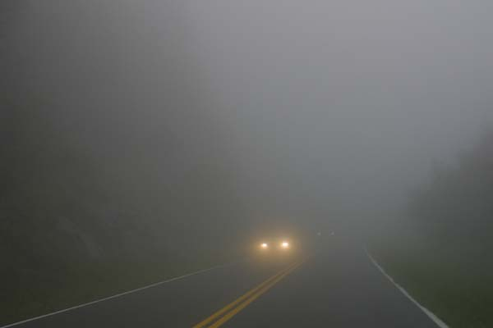
Top 5
Foggy Areas
For Fraud

Slide 18
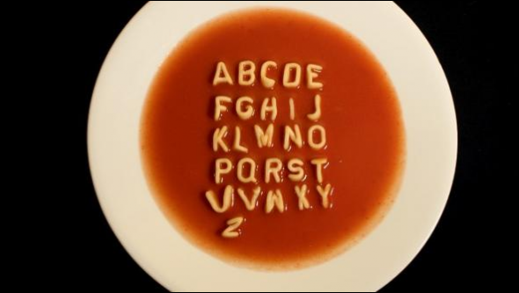
#5
False or Misleading “Certifications”
  Fake “senior” designations
Included in free CRD Reports

Slide 19

#4
Affinity Fraud
Join a group, using referrals to sell within the group
● Ethnic ● Social ● Religious

Slide 20

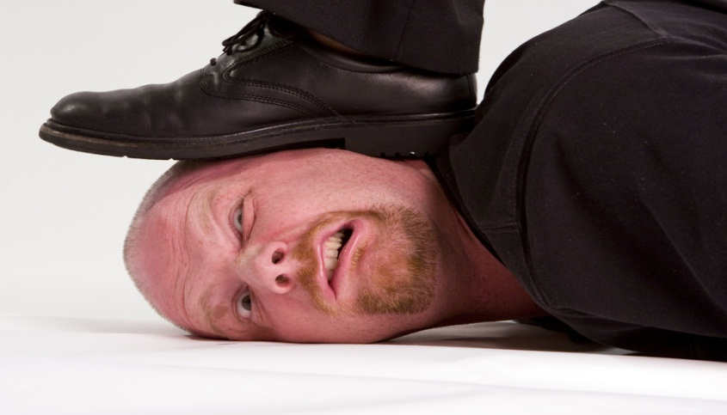
#3
Free Meal Investment Seminars
Free?
Fraud victims were 3 times more likely to attend
Professional sales presentation
Personal appointment later
Pressure
to
Buy

Slide 21

Social Networking
“Friend” or Foe?
#2
Internet
“Friend” a community leader
Pitch the investment later
Leader reports profits to their “friends”
Establish friendly rapport with new contact
Fake similar Likes & Dislikes; send friendly messages
Pitch the investment later

Slide 22
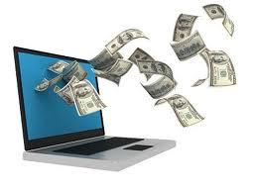
JOBS Act
#2 Internet
Allows new & small businesses
to raise capital from the “online crowd”
Raise up to $1M, sold through broker or “portal”
Exempt from SEC and state registration
Rules still to be written by SEC; not legal yet
Investors
Very high potential for fraud
Businesses seeking funding - could be swindled by unqualified or illegal “portals”
Notes:
initially used by creative people fund films and inventions
Portal = regulated 3rd party website
Term in the Art world
J
O
B
S
umpstart
ur
usiness
tartups
50% of small businesses fail within 5 yrs

Slide 23
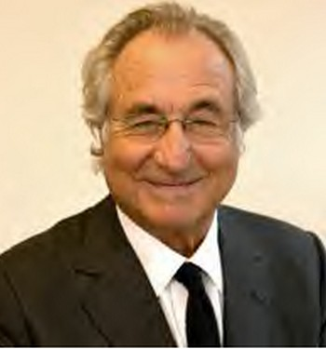
#1
Ponzi Scheme
Bernie Madoff, 72, former NASDAQ Commissioner
Swindled victims over 5 continents for decades out of
$65 B
Sentenced to 150 years in federal prison
Notes:
Give examples of cases

Slide 24
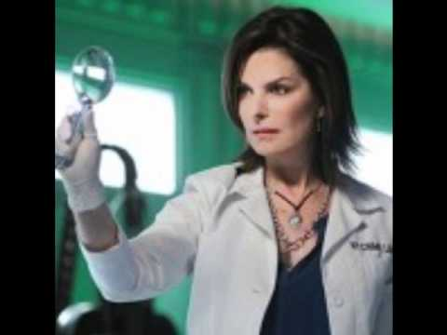
Check up!
Notes:
3rd Guard Rail

Slide 25
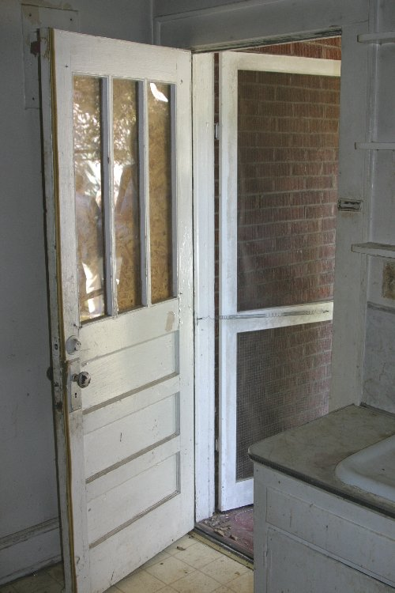
Risky Business
2007 FINRA Fraud Risk Survey
80%
NEVER checked if Broker
violated any laws
70%
NEVER checked Broker’s
registration with the state
Tricks of the Trade: Outsmarting Investment Fraud
NEVER checked into the Broker’s background
80%
Notes:
Legally registered
Or
Legally exempt

Slide 26

“Are you registered with the state to sell this security?”
NO
YES
Ask why not (take notes)
Call OFI to check if the reason is legitimate
OR to register a complaint
Ask for the person’s CRD Number or Legal name
Email a request to
complaints@ofi.la.gov
Notes:
What dispels the fog? Sunshine! Turn the light on….

Slide 27



Individual selling the product
May be Exempt from filing with OFI
What’s Required by Law?
The individual and the product sold are two separate things
Product (security) being sold
May be Exempt
from filing with OFI
Notes:
That depends on which category you’re discussing…
Investments that are NOT securities include:
Interest-bearing savings accounts
Some real estate investments
Gold, diamonds, etc.
Art
Collectibles
Commodities

Slide 28
What’s “on record” with OFI?
OR
OR
 | Register with OFI | Notice-of-Sale filed with OFI | Nothing with OFI
Individual
Product (Offering)
Note: Exemptions to Registration are available
Notes:
Includes
Out of State
Solicitations

Slide 29
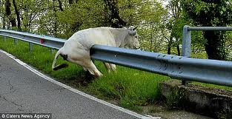
FREE
Background Checks
C.R.D. Reports
    Securities qualifications
    Certifications
    Pending arbitration
    Criminal history
    Bankruptcies
    Employment History, including:
    Terminations
    Disciplinary Actions
    Customer Complaints
Notes:
Central
Registration
Depository

Slide 30
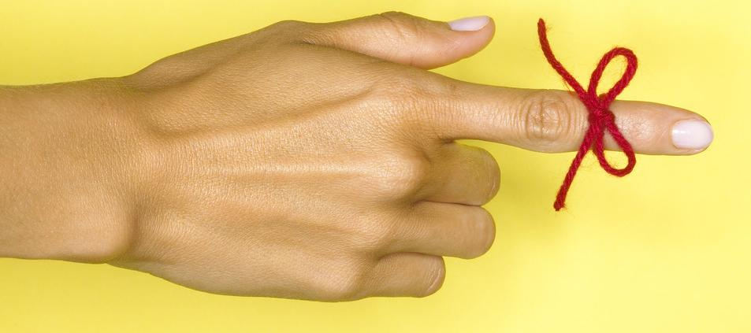

an’t
emember
etails
C
R
D
On Handout
For fastest service
Submit the person’s CRD Number or legal name
your request

Slide 31
Wise up
Wake up
Check up

