Slide 1

Combating Frauds Against the Elderly
A Partnership Working Together
John Maron
Director, Investor Education Program
NC Dept. of the Secretary of State
Securities Division
PO Box 29622
Raleigh, NC 27626-0622
(919) 807-2106
jmaron@sosnc.com
Notes:
I have titled my presentation “A Partnership Working Together” because that’s what this whole conference is designed to do.
I have two objectives with this presentation. The first is to provide context for what investment fraud is, the laws that are designed to protect investors, and the warning signs of investment fraud.
The second objective is to ask for your help to combat investment fraud, especially as it is directed towards the elderly.
I want you to view this presentation through two different lenses. First, as that of an investor. Everyone in this room is an investor and therefore can apply what I present to your own personal situations. I also want you to view this presentation as a partner in the prevention of fraud and exploitation of the elderly. I will discuss later how YOU can help us combat investment fraud.

Slide 2

Investment Fraud
Between 2004-2011, open securities and commodities fraud investigations increased from 1,139 to 1,846 (+62%).
During this time period, the losses associated with these types of schemes have increased to billions of dollars. (Est. $10B - #40B/yr)
In response, the FBI has added 91 agents since 2008 (+61%).
(Source: FBI’s 2010-2011 Financial Crimes Report)
Notes:
Investment fraud is a difficult type of white collar crime to quantify. Victims of a successful con may not find out that they are victims for months, years or decades. Witness the victims of Bernie Madoff, who conducted his fraud over the course of twenty years.
According to the most recent crime statistics from the FBI, however, the number of securities- and commodities-related fraud investigations have increased by 64% between 2004 and 2011.
Again, the losses are hard to quantify, but certainly they have been in the multiple billions of dollars. Currently, they are estimated at between $10B and $40B per year.
The federal response has been to increase the number of agents assigned to investigate such crimes by a corresponding percentage.

Slide 3
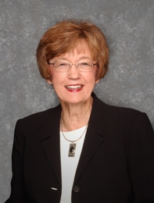
Investment Fraud
NC Dept. of the Secretary of State
Administers and Enforces:
NC Securities Act (N.C.G.S. § 78A)
NC Investment Advisers Act (N.C.G.S. § 78C)
NC Commodities Act (N.C.G.S. § 78D)
Notes:
The North Carolina Department of the Secretary of State is responsible for enforcing the North Carolina Securities Act, the North Carolina Investment Advisers Act and the North Carolina Commodities Act (Chapters 78A, 78C and 78D, respectively, of the North Carolina General Statutes). This includes handling complaints, conducting investigations of alleged violations of the Acts that are administrative, civil and criminal, depending on the state’s jurisdiction, and making referrals to law enforcement officials.

Slide 4
What is a “security”?
Full definition is found at N.C.G.S. §78A-2(11); however, in general:
A “security” is any investment in which the investor has a reasonable expectation of making a profit as the result of the managerial or entrepreneurial efforts of others.
Notes:
There is no black and white definition of what a “security” is. The NC statute simply lists a number of financial products that are specifically classified to be – or not to be – “securities”.
However, so that everyone can understand what a security is, it can be generally said that a security is ANY investment in which the investor has reasonably expectation of making a profit based on the entrepreneurial or managerial skills of someone else.
Not the PASSIVE relationship between you and your money and the success (or failure) of the venture. If you are being offered an opportunity to invest in something, and you will have no control of or say over how the venture will be managed, and the only thing you are being asked for is your money, then chances are good the venture involves a security. And this matters because (next slide)….

Slide 5
Registration Requirements
With limited exceptions, anyone who sells a security or provides investment advice must be licensed and registered with the Securities Division.
With limited exceptions, all securities must be registered with the Securities Division.
Notes:
…with limited exceptions, anyone who sells a security or provides investment advice about a security must be registered with the NC Securities Division.
Not only must the person be registered, but the actual investment product itself must be registered as well.
So, now you know that there is a state agency you can call to check to see if the person trying to get you to invest in something is registered and whether the investment itself is registered. If neither is registered, you need to do some further investigation because this is a major red flag that you may be walking into a fraudulent investment scheme.
And you should know that every single broker and every single investment adviser nationwide must be registered. The NC Securities Division has access to the database of all registered brokers and investment advisers, so it doesn’t matter where the person resides. If they are selling investment products or services into North Carolina, we have jurisdiction. We can also provide information about the employment or disciplinary history of each of these types of people. All of this is powerful information for you the investor. It only takes 5 minutes to call and speak with one of our registration agents. Taking that five minutes to make the call could prevent you from losing your entire life’s savings.

Slide 6
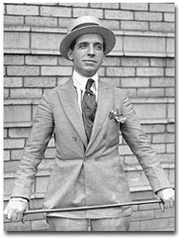
Types of Scams
I immigrated to the US in 1903 at age 20.
In 1920, I devised a scheme that still bears my name today.
I opened a company in Boston telling investors that I could provide a 100% return in just 90 days.
Notes:
Let me now talk about some of the common scams we see. Before I do, though, I want to introduce you to my good friend here, without who I would not be here today.
(The rest is self-evident based on the slide.)

Slide 7
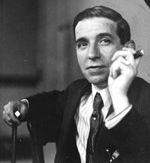
Types of Scams
I was deluged by investors, taking in $1M in one 3-hour period.
I went from being penniless to exceedingly rich to penniless and imprisoned in less than a year.
Notes:
(This slide is self-evident based on the narrative.)

Slide 8
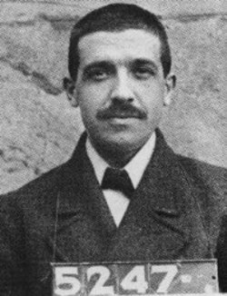
Types of Scams
By the time I was exposed, I had taken investors for $10M - $15M while only investing ~$50.
What is my name?
My name is:
Charles Ponzi
and similar scams are referred to even today as “Ponzi Schemes.”
Notes:
(This slide is self-evident based on the narrative.)

Slide 9
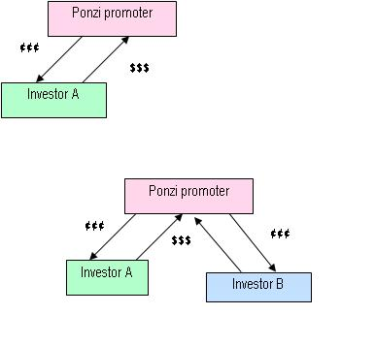
Ponzi Schemes
A Ponzi scheme is a fraudulent investment operation. It involves paying atypical returns to investors. These so-called profits are paid out of the money paid in by subsequent investors and not from revenues generated by any real business.
Notes:
(This slide is self-evident based on the narrative.)

Slide 10
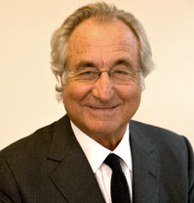
Ponzi Schemes Are Alive & “Well”
This fellow was convicted of pulling off the biggest Ponzi scheme in history.
Notes:
(This slide is self-evident based on the narrative.)

Slide 11
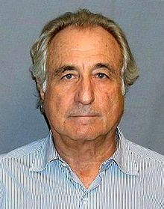
Ponzi Schemes Are Alive & “Well”
He is believed to have “made off” with $20 billion in investor money.
Notes:
(This slide is self-evident based on the narrative.)

Slide 12
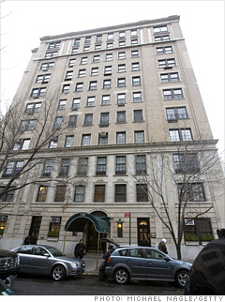

Ponzi Schemes Are Alive & “Well”
He used to live here.
He used to own this.
Notes:
(This slide is self-evident based on the narrative.)

Slide 13
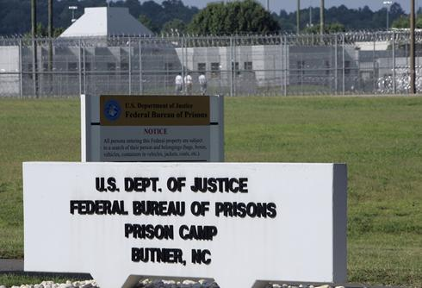
Ponzi Schemes Are Alive & “Well”
Now he lives here.
Notes:
(This slide is self-evident based on the narrative.)

Slide 14
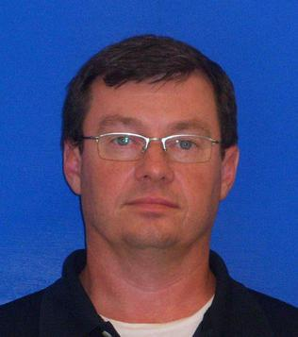
Ponzi Schemes Are Alive & “Well”
(Even in North Carolina!)
Lived in Catawba Co.
Active from 1991-2008
Sold fake promissory notes
Snared approximately 500 investors, bilking them out of ~$25M
Victims included:
  Friends
  Church members
  Family
    Even Mother and Father!
J.V. Huffman, Jr.
Notes:
But Ponzi Schemes are not the purview of just New York. We have them right here in North Carolina. Let me introduce you to a few people.
(This slide is self-evident based on the narrative.)

Slide 15
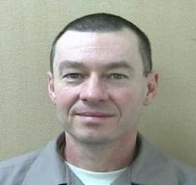
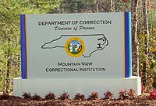
Ponzi Schemes Are Alive & “Well”
(Even in North Carolina!)
Pleaded guilty in Jan ‘10 to 28 felony counts, including 14 counts of securities fraud
Sentenced to 30 – 40.5 years
J.V. Huffman, Jr.
DOC #1188382
Notes:
(This slide is self-evident based on the narrative.)

Slide 16
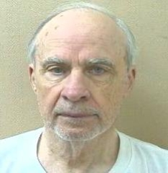
Ponzi Schemes Are Alive & “Well”
(Even in North Carolina!)
D. Martin Enterprises Mooresville, NC (Iredell Co.)
1/04 to 12/08, collected ~$18.5M from 100+ investors
Money for venture capital
Guaranteed 10-50% returns/yr
Pleaded guilty 6/30/11 to 19 felony counts of securities fraud
Sentenced 6/30 to 9.8 – 13+ years in state prison and must repay $5.35M to victims.
Shelby Dean Martin
DOC #1272223
Notes:
(This slide is self-evident based on the narrative.)

Slide 17
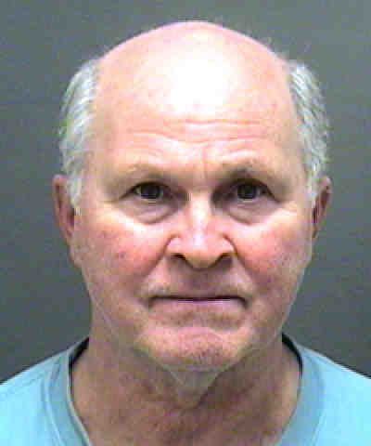
Ponzi Schemes Are Alive & “Well”
(Even in North Carolina!)
Queen Shoals, LLC; Queen Shoals II, LLC & Select Fund LLC
2006-09 took +$30M from 100+ investors by falsely claiming profitable trading in T-bills, precious metals & foreign currencies
5-yr prom notes guaranteeing 8-24% via “non-depletion acounts”
Pled guilty 7/09 to securities & mail fraud & sentenced 3/11 to 22 yrs in prison. 11/11 ordered to pay $24M in restitution & civil penalties
Sidney S. Hanson
Fed. Reg. #23422-058
Notes:
(This slide is self-evident based on the narrative.)

Slide 18
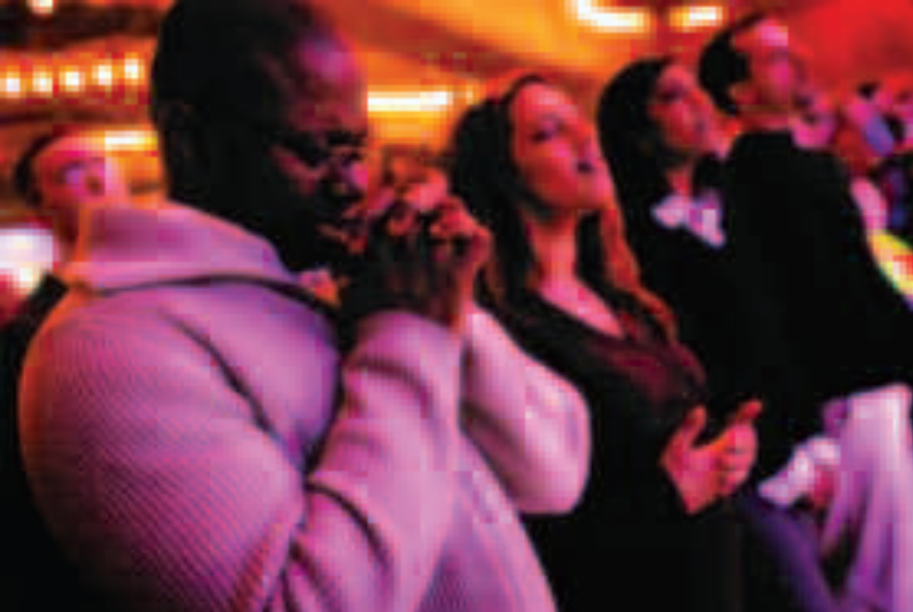
Affinity Fraud
Fraud aimed at members of a group sharing a common characteristic.
Targets: Seniors, ethnic groups, religious groups, professional or civic groups.
Con man: “You can trust me because I’m just like you.”
Notes:
As bad as the financial devastation that these three men wrought against their victims, the social damage was just as great. Why? Because each of these three men engaged in what we call “affinity fraud” because they preyed on their victims’ faith. Each portrayed himself as a “good Christian”.
Affinity fraud is fraud that is aimed at groups of people who share common characteristics.
Successful con artists are wonderful human psychologists. They know that we humans like to associate with people who are like ourselves.
Think for a moment about your own personal life. Think about the circles you have. You have family circles, friendship circles, social circles, professional, ethnic, and religious circles -- we define ourselves by the circles we walk in.
Con artists know this. What they’ll do is infiltrate a group. They will figure out who the influential members are and pitch those individuals a “can’t miss” investment opportunity. They will “hook” them by making good on the promised return on the investment as a way to “prove” the legitimacy of the deal. Then they will sit back and wait for word of mouth to work its way through the group.
One of two things will happen: Either you will never hear from the person again because he has absconded with the money; or you will turn on the evening news and see the fellow doing the “perp walk.” All Ponzi schemes are doomed to fail because the con artist will eventually run out of new victims to pay off earlier investors.

Slide 19
Frauds Aimed at Senior Citizens
Seniors are the #1 target of fraudsters
Why?
$enior$ are $aver$ with acce$$ to ca$h!
Notes:
So what group is the Number One target of investment fraud? Seniors.
Why? Because they have the cash. They are at the stage of life in which their assets are the most easily liquidated. Plus, through virtue of a lifetime of experience and habit, seniors are savers. Con artists are looking for folks with money, and seniors, as a general class, have the money.

Slide 20
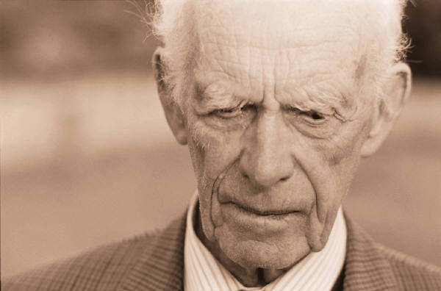
Frauds Aimed at Senior Citizens
Empirical Evidence
57% of fraud victims are 50+ years old. (AARP, 2001)
20% of seniors 65+ (~7.3 million) have been the victim of a financial crime (IPT, 2010)
In NC, ~50% of all enforcement actions involve senior fraud.
Notes:
Some empirical evidence to support the claim that seniors are the Number One target.
(This slide is self-evident based on the narrative.)

Slide 21
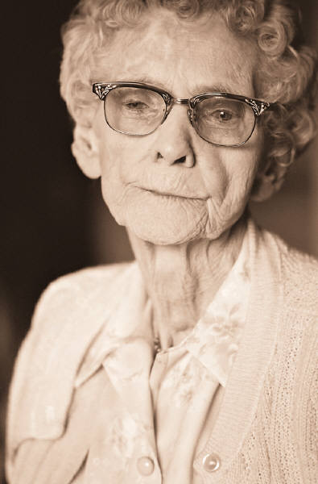
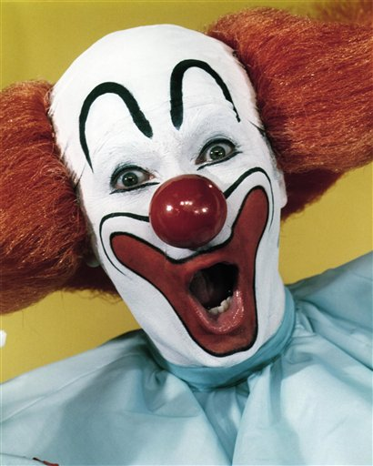
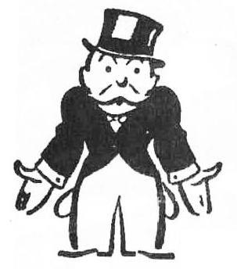
Frauds Aimed at Senior Citizens
Who Is the Typical Investment Fraud Victim?
Perceived victims of investment frauds are:
Little old widow women
Real “Bozos”
The poor trying to hit it big
Notes:
We have a stereotypical view as to who the typical investment fraud victim is. We tend to think that it’s just the little old widow woman who is victimized. We also think that only “bozos” can be duped and that victims are the poor or those people who are trying to hit a home run.

Slide 22
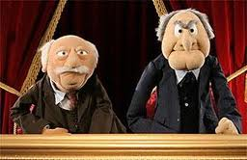

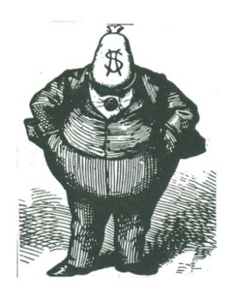

Frauds Aimed at Senior Citizens
Exploding the Myths about Investment Fraud
In reality, victims are more likely:
To be male
To be college educated
Have incomes >$50K
To trust their own judgment
National Fraud Victim Study
(March 2011, AARP Foundation)
Notes:
Well, in reality, the opposite is true.
Most victims of investment fraud are men.
Most are college educated.
Most have incomes greater than $50K.
And most are men who trust their own judgment rather than seeking the advice or information from reliable sources.
Look at the victims of Bernie Madoff – they were CEOs, CFOs, economists, etc. These were supposedly “smart”, “well-educated” and “savvy” people. If they can be duped, anyone can be duped.

Slide 23
Sadly, There Are Other Risk Factors
A 2008 Duke University study found that about 35 percent of people over age 71 (~9 M) in the U.S. either have mild cognitive impairment (MCI) or Alzheimer’s disease. (Plassman et al., Ann Intern Med. 2008; 148:427-434)
A 2012 UCLA brain study found that the region of the brain important to discerning untrustworthy faces (anterior insula) is less active in older adults, making them less sensitive to cues related to trust. (Neural and behavioral bases of age differences in perceptions of trust PNAS 2012 109 (51) 20848-20852)
These findings help explain why the elderly are more vulnerable to financial exploitation, including investment fraud.
Notes:
But, of course, there are other risk factors making the elderly vulnerable to such crimes.
(This slide is self-evident based on the narrative.)

Slide 24
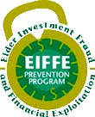
Solutions
Elder Investment Fraud and Financial Exploitation Prevention Program (EIFFE)
2-year grant project
NC and 23 other states to train doctors
  (~200 in NC)
Docs to refer patients to local resources like APS
APS refers investment fraud to NC SOS
Notes:
So, what are some solutions to combating this type of crime?
Well, this is the part of my presentation where I want to underscore the need for partnership. This is where I want you to look at things through the lens of protecting seniors. Up to this point my focus was to provide context for understanding what securities fraud is, the tricks con artists use and the protections provided by state and federal law.
One solution to conduct a vigorous public outreach campaign across the state – and we have done that. Between us, I and my colleague, Barbara Bennett, have conducted almost 600 presentations to more than 38,000 people in all 100 counties over the past 7 years.
But we can’t do it by ourselves. We need the partnership of others.
One such partnership solution is the Elder Investment Fraud and Financial Exploitation Prevention Program, also known as “EIFFE”. This is a 2-year project that North Carolina and 23 other states are engaged in that is designed primarily to educate physicians with elderly patients to use their powers of observation and their patient interview process to be vigilant to the signs of potential financial abuse or exploitation. Although designed for physicians, any adult services provider can participate. If abuse or exploitation are suspected, the provider is encouraged to refer or report the patient or caregiver (if not the one suspected of the abuse) to appropriate community-based resources like Adult Protective Services (APS). We also provide training to APS officials to understand what investment fraud is.
So far, we have conducted several training events here in North Carolina, including the NC Academy of Family Physicians, the J. Paul Sticht Center in Winston-Salem, the Mountain Area Health Education Center (MAHEC) as well as various other groups providing services to seniors. We are planning other events and hope to conduct one here in Wilmington at SEAHEC later this year.

Slide 25
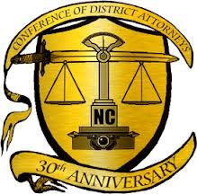
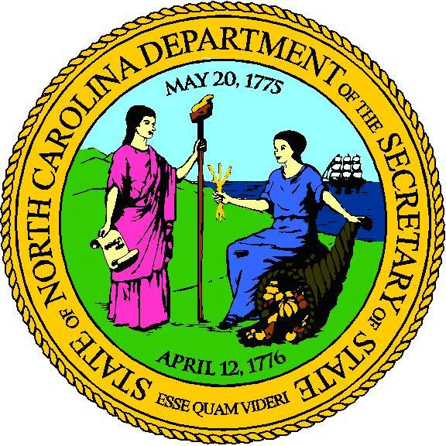
Solutions
Elder Fraud Conference
First of its kind in NC
Multi-disciplinary approach
Establish relationships and lines of communication/cooperation
Notes:
Another solution is events like this Elder Fraud conference that brings together multiple agencies that each has a responsibility to help protect the elderly. This conference was designed to get agencies talking to one another and to collaborate when possible. We in the Secretary of State’s office are proud to be a cosponsor of this conference with the NC Conference of District Attorneys.

Slide 26

Recap: Warning Signs of Fraud
Promises of high returns with “little or no risk” – “guarantees”
Pressure to make quick decision.
Highly emotional appeals.
Offers to help “make back” lost money.
Notes:
(This slide is self-evident based on the narrative.)

Slide 27
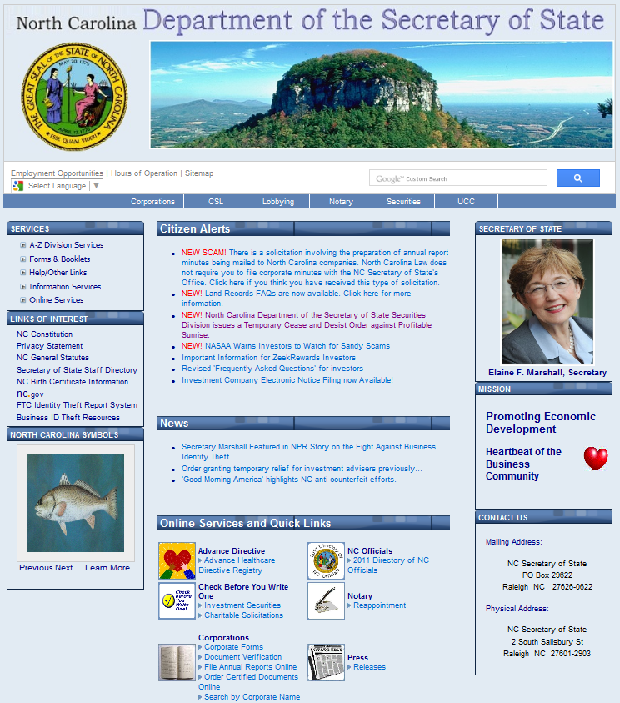
For More Information
NC Securities Division (1-800-688-4507)
www.SOSNC.com or www.SOS.NC.gov
Notes:
(This slide is self-evident based on the narrative.)

Slide 28
Conclusion
If an investment sounds too good to be true –
IT IS!!!
Don’t let embarrassment prevent you from calling the Securities Division.
Don’t invest until you call the Securities Division (1-800-688-4507) to check the registration of the product and promoter.
NC Dept of the Secretary of State
Securities Division
PO Box 29622
Raleigh, NC 27626-0622
Phone: (800) 688-4507
Email: secdiv@sosnc.com
Internet: http://www.sosnc.com
Notes:
(This slide is self-evident based on the narrative.)
At this time, I would like to turn things over to my colleague, Allan Russ, Senior Enforcement Attorney and Deputy Director of the North Carolina Securities Division, who will provide more in-depth information about the various types of scams that keep us awake at night.

