Slide 1
NASAA EFD:
Industry Training
Send any questions to JW@NASAA.ORG
Thursday– February 05, 2015: 2 pm EST

Slide 2
REMINDERS
Phones are automatically muted through this software.
Send any questions to JW@NASAA.ORG and we will try to answer them at the end of the presentation.

Slide 3
EFD Updates
SEC emails were modified in December to include a link to www.efdnasaa.org for everyone to continue their notice filing process with individual States.
The EFD Support Desk is fully operational and ready to take your calls.
They can assist you:
  Setting up new user accounts
  Setting up group accounts
  Resetting passwords
  Finding an offering

Slide 4
EFD Support Information
  Hours of Operation (24/7 – except maintenance)
  Help Desk Support (9-6 Eastern)
    support@efdnasaa.org
    Phone: 601-453-1979
  User Manuals (coming soon)
  Previous Webinar Recordings are available at www.nasaa.org/efd
  Frequently Asked Questions (FAQs)
    www.efdnasaa.org/faq

Slide 5
EFD: Getting Started
Overview

Slide 6
www.efdnasaa.org
Website Demonstration
Navigation Overview and Walk Through
User Registration and Group Management
Creating New Filing Notices
Renewals / Terminations / Withdrawals
1st Time Digitization of Offering Notices to States
Managing Notices and Receipts
Managing Deficiencies
Page 1

Slide 7
Quick Walk Through
Register your account
Account Registration
Search to find your Offering
Select States for Notices
Make Payment
Search by:
  EFDID
  Accession
  Central Index Key (CIK)
  Issuer Name
  Related Persons
  CRD Number
  State File Number
  Form D Signatures
41 Participating States
Remaining states are working to participate
Your filing notices are then Completed
Visible to the public as Filed
Page 2

Slide 8
Group Administrators and
User Management
Each User of EFD should create their own individual account using their individual email address. EFD Groups can be created to link EFD user accounts together.
EFD can help you organize your team by creating and maintaining Groups
Group Administrators manage:
  Group membership and access to the EFD system
  All filing notices and filers within the Group
Users always manage their own notices but may be assigned additional notices by their Group Administrator
Page 3

Slide 9
System Use Fee Explained
One-time system use fees are assessed per offering made at EDGAR.
One System Use Fee is assessed whether you are filing in one or many states.
Good for the life of the offering (and all state notices) including:
  Renewals
  Amendments
  Terminations
  Withdrawals
System Use Fees cover the costs of hosting, maintenance and support of the EFD system.
Page 4

Slide 10
1st Time Digitizations
1st Time Digitization of any offering will result in a system use fee.
Example: You’ve paper filed with a state last year and now you are “digitizing” your notice filing with EFD. Even though this is a “renewal” for your offering notice in a state, this is considered a 1st time digitization at EFD and a system use fee will be charged for the offering.
Page 5

Slide 11
Payment Options
Currently ACH is the only available payment option.
Credit Cards are being considered and will be potentially implemented soon.
ACH is not a wire transfer. It is much more like an online check and you should not be assessed a fee from your bank for using the ACH payment option at EFD.
Page 6

Slide 12
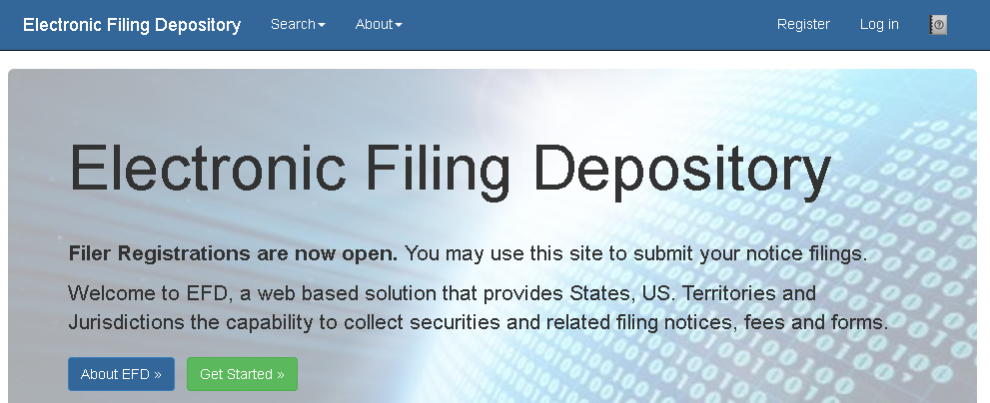
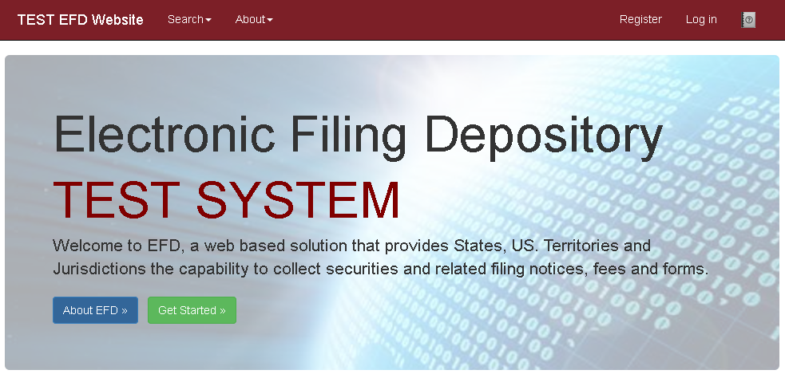
Website Demonstration
The production EFD site is BLUE
The demonstration EFD site is RED
Page 7

Slide 13
www.efdnasaa.org
Questions and Answers
Questions received from participants.
Contact Jason Wolf (jw@nasaa.org) for any further questions you may have after this presentation.
EFD Support is here for you to answer any questions. Please don’t hesitate to give us a call.
Thank you for joining!
Page 8

