Slide 1
NASAA Fall Conference 2012 Joint Web CRD/IARD Forum
Overview: Revisions to
Form ADV Part 1B*
*These slides provide an overview to some of the revisions to Form ADV Part 1B, but are not intended to provide a comprehensive presentation of the revisions. Please consult the revised Form ADV Part 1B to see the totality of the revisions.

Slide 2
Revisions to Form ADV Part 1B
On July 23, 2012, NASAA’s CRD/IARD Steering Committee proposed a series of revisions to Form ADV Part 1B for which the public comment period ran through August 13, 2012.
The following items were revised: 2.A., 2.C., 2.D., 2.G., 2.I. and 2.K.; Disclosure Reporting Pages (DRPs) were also revised.
NASAA members approved the revisions at the Business Meeting on Sunday, September 10, 2012.

Slide 3
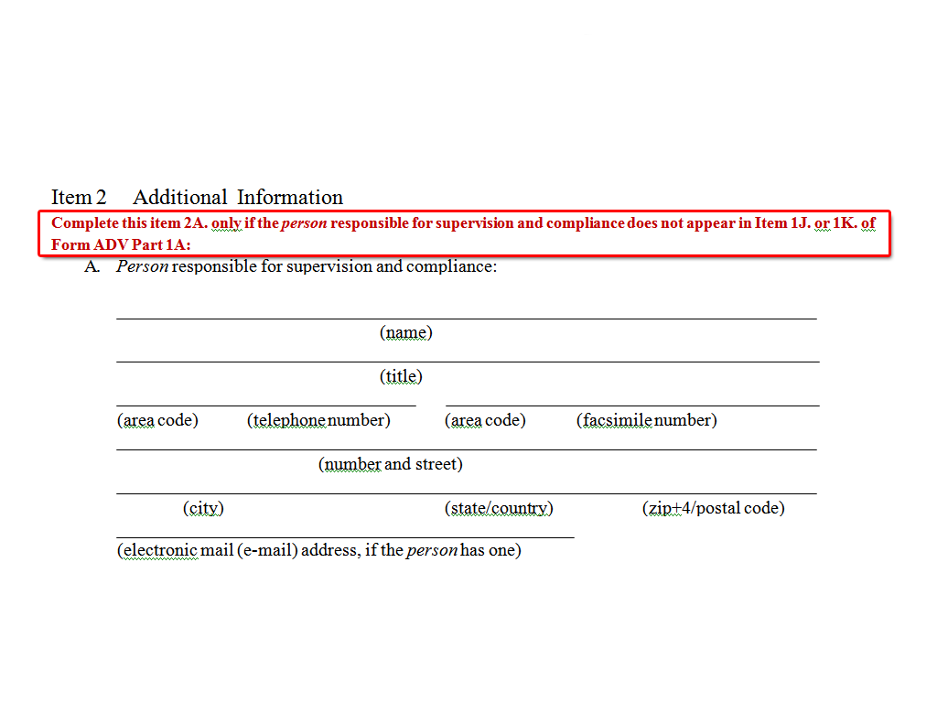
Item 2.A. Supervision / Compliance
FORM ADV
Part 1B
Page 1 of 4

Slide 4
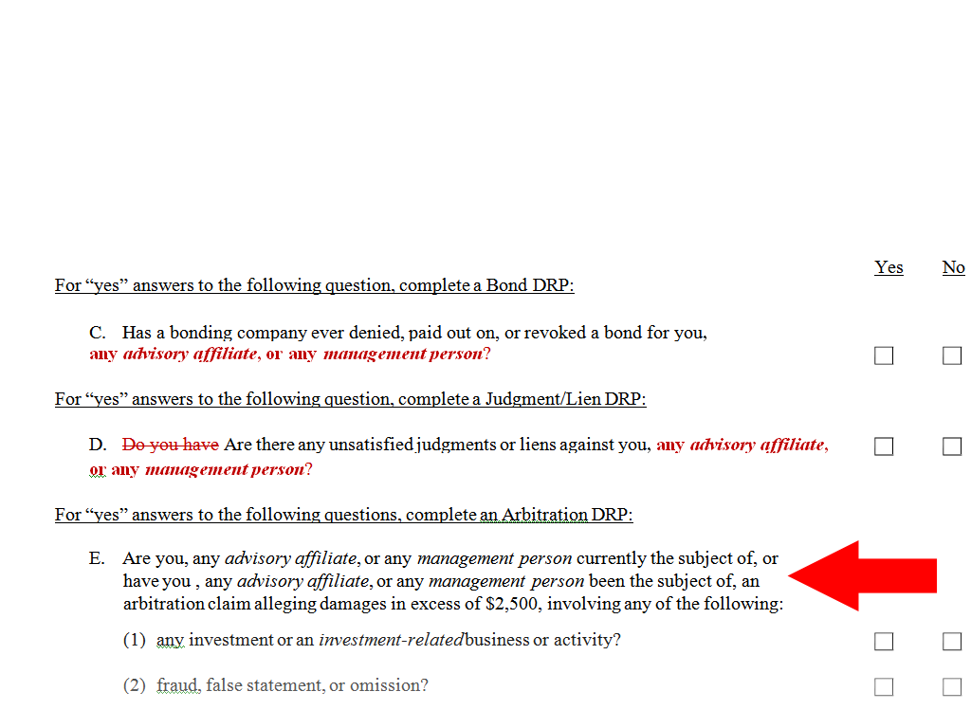
Items 2.C & 2.D Now Include Advisory Affiliates & Management Persons
(Similar to Item 2. E.)
FORM ADV
Part 1B
Page 2 of 4

Slide 5
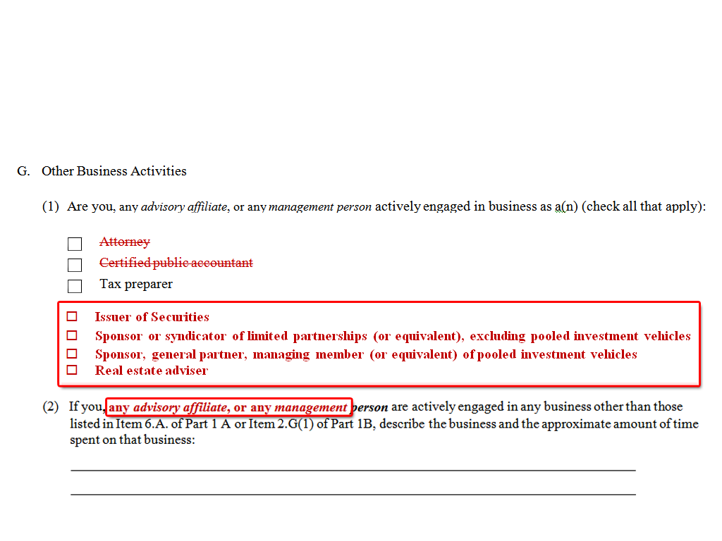
Item 2.G. Other Business Activities
FORM ADV
Part 1B
Page 3 of 4

Slide 6
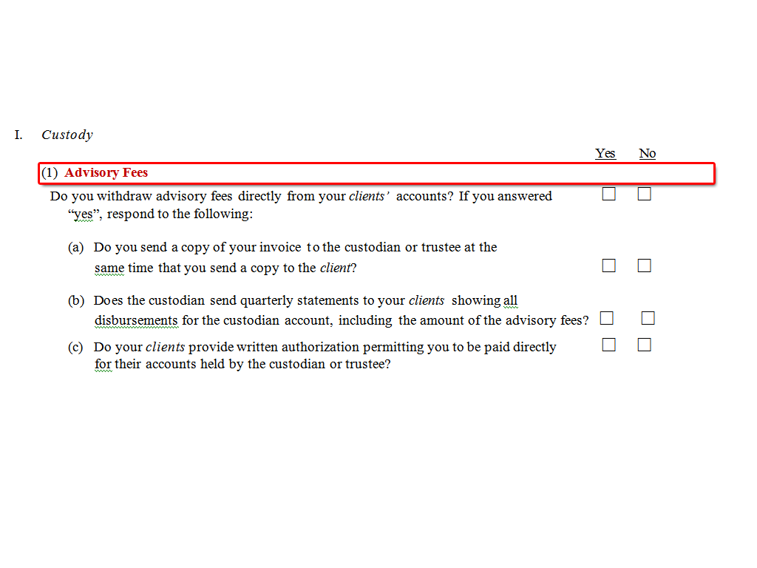
ITEM 2.I. Custody
ITEM 2.I.(1): Addition of Title
FORM ADV
Part 1B
Page 3 of 4

Slide 7
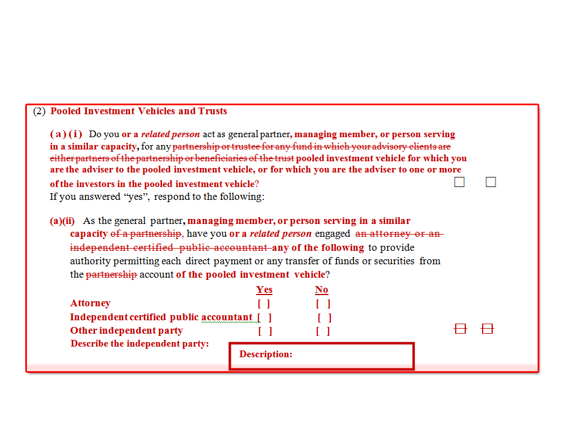
ITEM 2.I. Custody
ITEM 2.I.(2): Expanded Scope
FORM ADV
Part 1B
Page 3 of 4

Slide 8
Item 2.I. Custody
Item 2.I.(2)(a)(ii): Independent Party
Item 2.I.(2)(b): Trust Relationships
FORM ADV
Part 1B
Page 4 of 4

Slide 9
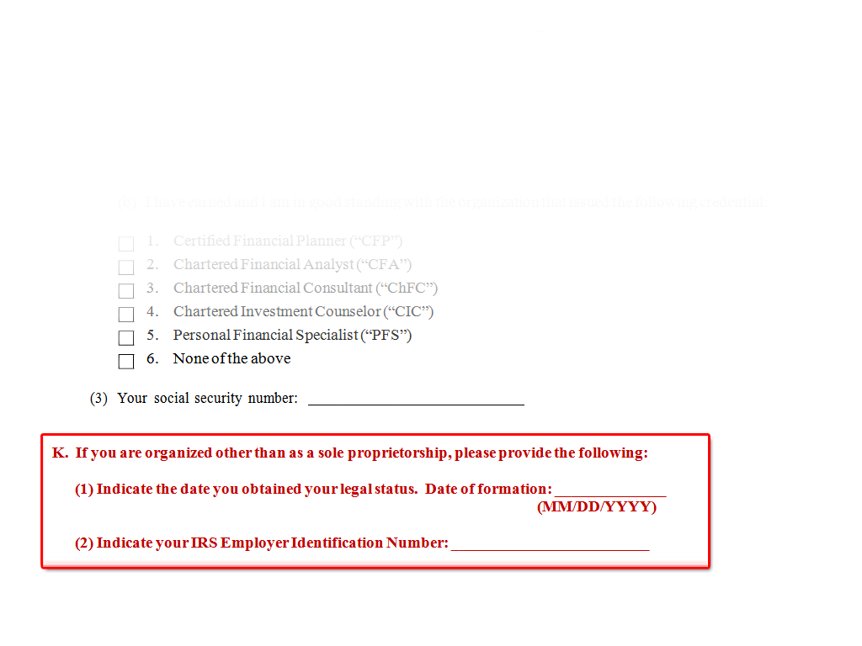
New Item 2.K.: Date of Formation
FORM ADV
Part 1B
Page 4 of 4

Slide 10
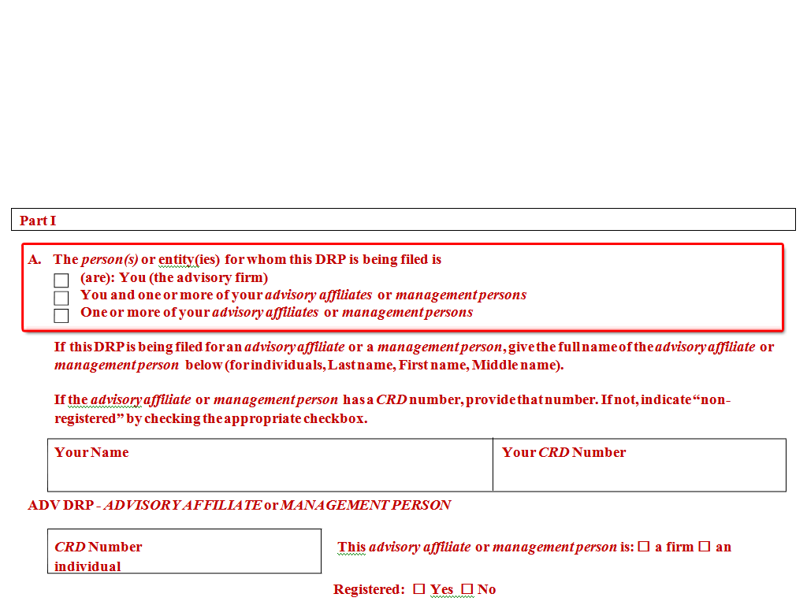
BOND DISCLOSURE REPORTING PAGE (ADV)

Slide 11
JUDGMENT/LIEN DISCLOSURE REPORTING PAGE (ADV)

Slide 12
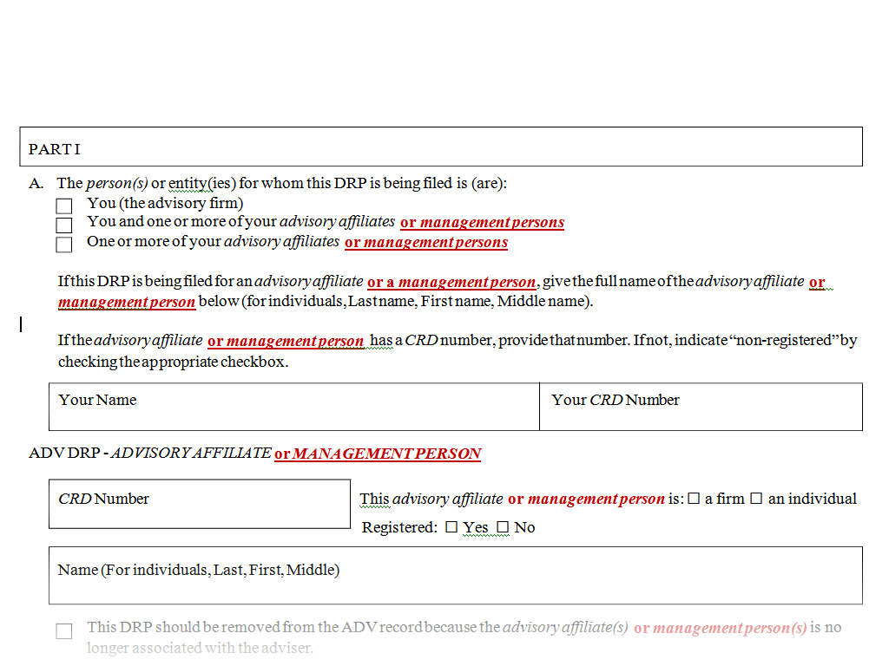
ARBITRATION DISCLOSURE REPORTING PAGE (ADV)

Slide 13
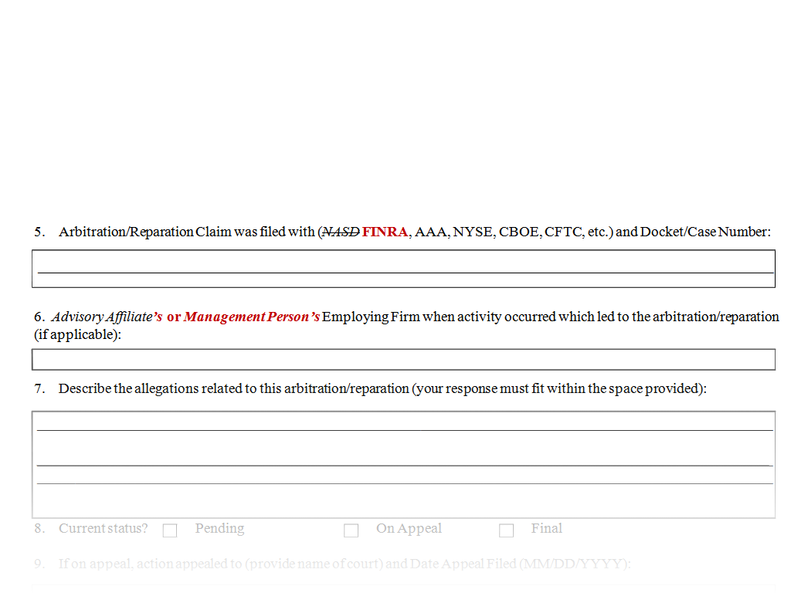
ARBITRATION DISCLOSURE REPORTING PAGE (ADV) (Cont’d)

Slide 14
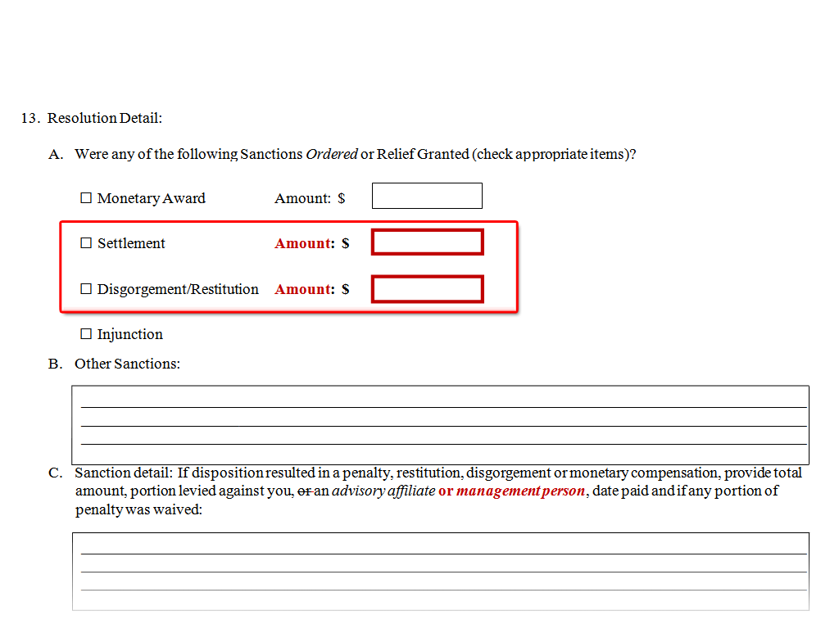
ARBITRATION DISCLOSURE REPORTING PAGE (ADV)

