Slide 1

Investor Self-Defense
Presented by
Nancy Boudreaux
Investor Education Trainer
Louisiana Office of Financial Institutions

Slide 2

Definitions

Slide 3


“Blue Sky” Laws
Each State has its own Securities laws and rules
that protect the general public from fraud
by regulating the offering and sale of securities
Notes:
This allows investors to base their judgments on trustworthy data.
“umbrella” term for state laws in U.S. that regulate the offering & sale of securities (NASAA 2010-11 Report)

Slide 4

“Full Disclosure”
Investors are entitled to complete, accurate and detailed information about the offering
Salespersons and issuers
have an affirmative obligation
to provide complete disclosure to investors

Slide 5
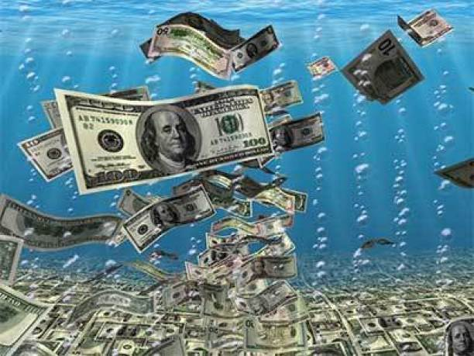
“Liquidity”
Ease of converting your security into CASH
Stocks
Most can convert to cash if there’s a market for it
NOTE: The value could be lower
Long-term CDs & Limited Partnerships
  Involve commitments of 5-10 years
  Generally, no secondary market on which the interests
  can be sold
Notes:
If no market for the stock, it is ILLIQUID!
Per Lynn (Montana), CD’s & limited partnerships may be sold – why used the word “generally”

Slide 6
“Churning”
Buy
Sell
Buy
Unnecessary buying and selling by a securities promoter to increase commissions
Beware of excessive “end-of-month” buying & selling
Always check your statements and stay involved

Slide 7
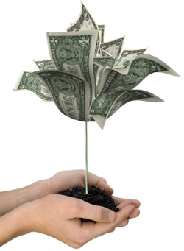
“Fiduciary” Duty
“Client-first” Rule – applies to Investment Advisers
Recommend only investments that are in the best interest of
the client
“Suitablity” Rule – applies to Brokers and Broker-dealer agents
Recommend investments that are suitable or meet the
client’s needs
NOTE: NASAA is urging Congress to legislate that all investment
professionals operate under a “client-first” rule, often
referred to as fiduciary duty

Slide 8
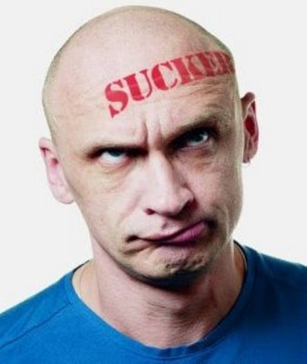
“Sucker” Lists
Lists with contact information of people who have previously
been successfully solicited
The lists are sold, generating even more “junk” mail and
telephone solicitations
Sign up for the “Do Not Call” List
Notes:
Especially true for people entering sweepstakes contests & telemarketing fraud

Slide 9

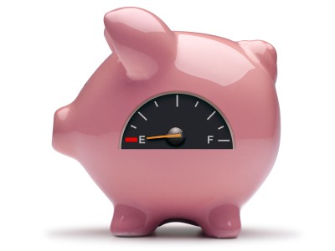
“Reload” Scam
Often done by telephone
Targets prior victims of scams OR those who lost money in a previous investment
Promotions to those panicked by a financial loss
  Invest in a “sure thing”
  Pay legal fees to recover
  lost money
  Pay taxes/fees for money
  already recovered
Notes:
Promises to make good on the original investment and to generate even greater returns. Purpose: to wipe out the rest of your savings.
In reality, investor loses whatever savings are left
Victims are more susceptible to pressure after the first losses, perhaps because:
Hope to recover money previously invested (desperate)
Inability to say "no" to a con man

Slide 10
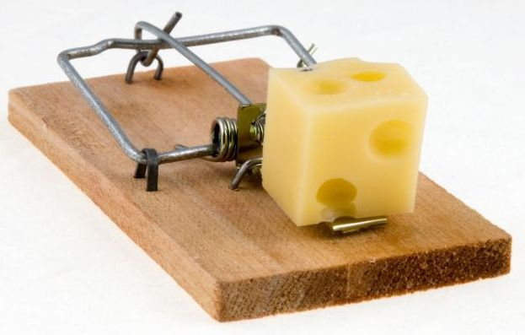
“Bait & Switch”
Scam
High
interest
Advertisements of an investment with unusually high profit; sometimes a personal visit is required
2. At the personal meeting, promoter discourages
investing in the advertised product, switching
them to a different investment

Slide 11

“Pump & Dump” Scam
False online “tips” are posted
OR
misleading research reports are posted on “investment research websites” run and owned by the fraudster
More stock is purchased by investors, raising the value of the stock

Slide 12
3. As value peaks, the owners sell or dump their
shares for highest profits
4. Investors are left with heavy losses as the stock value
crashes

Slide 13


Watch out for the
“Halo Effect”
or
Notes:
You have $10,000 to invest, and are looking for someone to handle it for you.
#1 Ask half the room to write some attributes of the man with the glasses
#2 Ask the other half of the room to write down some attributes of the man with the beard
Study at Princeton University, funded by grant FINRA (May 2011)- how Halo impacts investing decisions
Dress, Title & prestigious education of a promoter – assumed the promoter competent & less in need of a background check AND invested more money
One of several sub-conscious biases that can impact decision making – JUST BY LEARNING ABOUT THIS makes you less vulnerable – so look past the bright smile, fancy title or flashy suit AND TAKE THE SHINE OFF THE HALO EFFECT

Slide 14
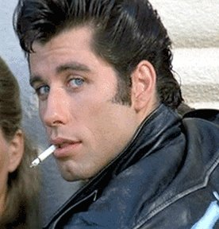
  “Bad Boy” Provision
  A condition that a security can’t be sold by
bad boys
i.e., those who have violated other securities laws

Slide 15

Resources
Websites

Slide 16
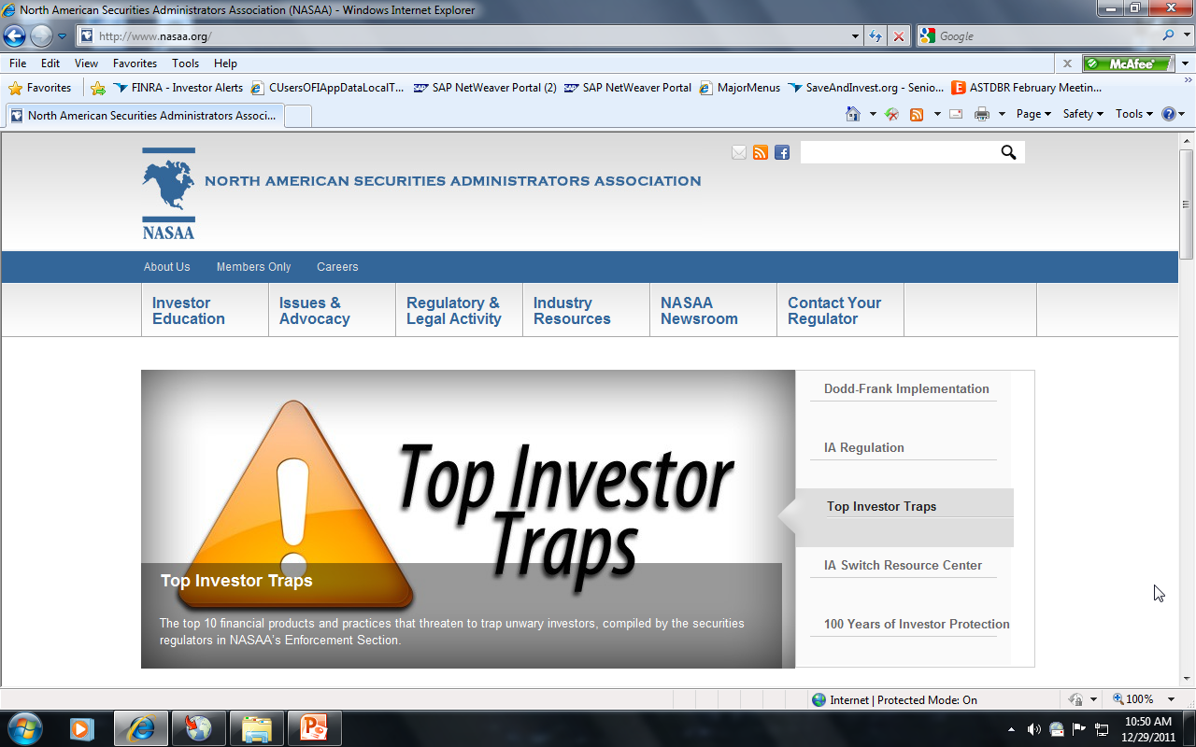

www.nasaa.org
North American Securities Administrators Association
Oldest international investor protection organization (1919)
Association of state securities administrators in the U.S., Canada, Mexico, Puerto Rico & U.S. Virgin Islands
orth
merican
ecurities
dministrators
ssociation

Slide 17
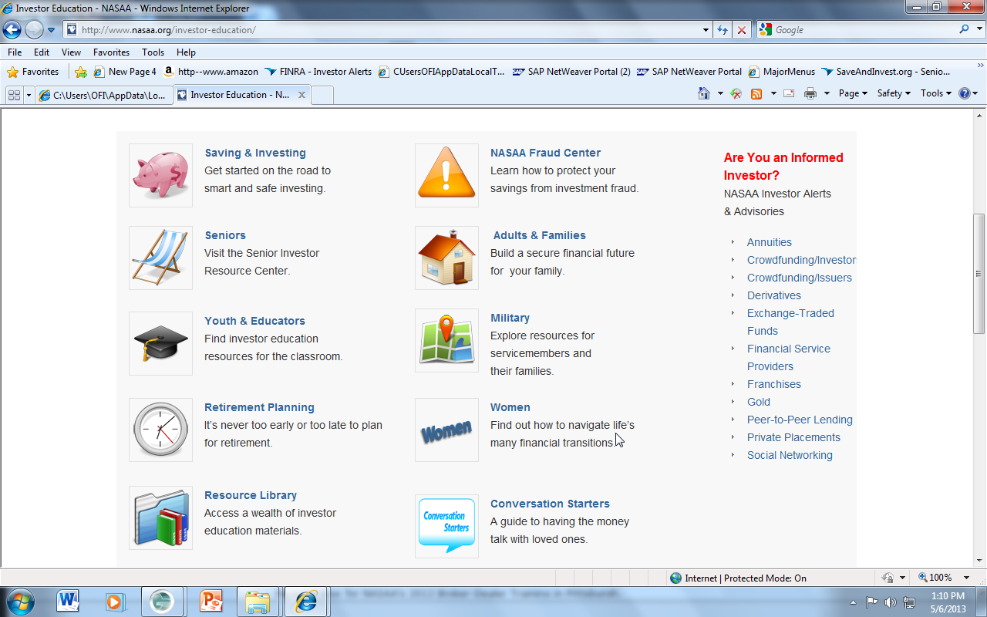
www.nasaa.org/investor-education/
Saving & Investing
Fraud Center
Alerts
Informed Investor
Seniors
Adults & Families
Youth & Educators
Military
Retirement Planning
Women
Resource Library
Conversation Starters
Empty Nest, Couples, Families,
Military, At work, In Crisis

Slide 18

S
E
C
ecurities
xchange
ommission
Federal agency oversees fair, orderly, and efficient markets, protects investors, and fosters capital formation to help the economy

Slide 19
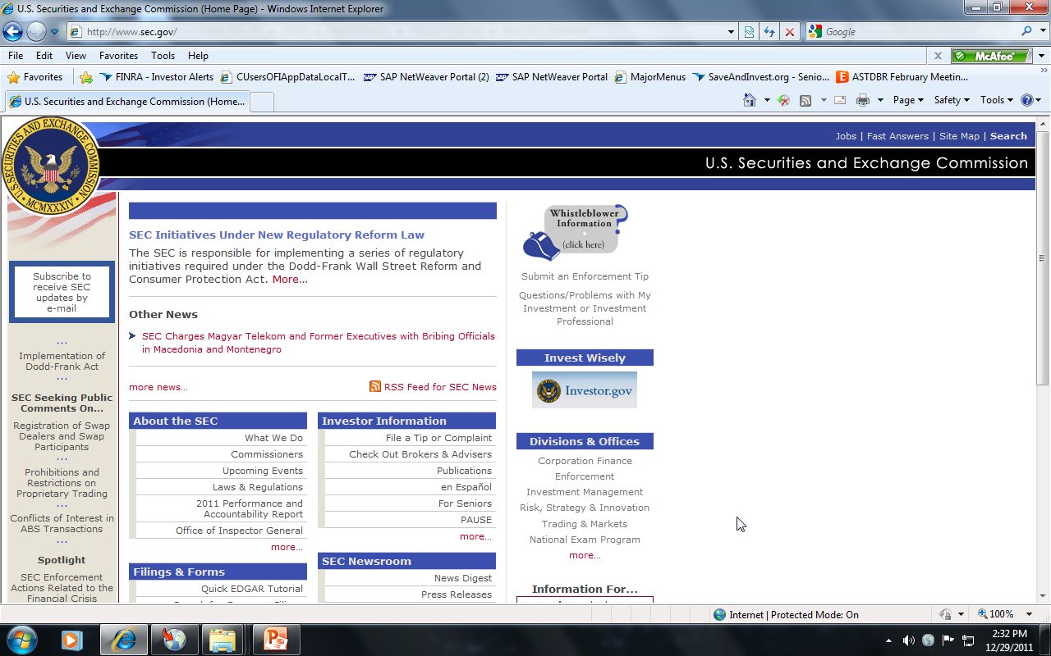
www.sec.gov

Slide 20
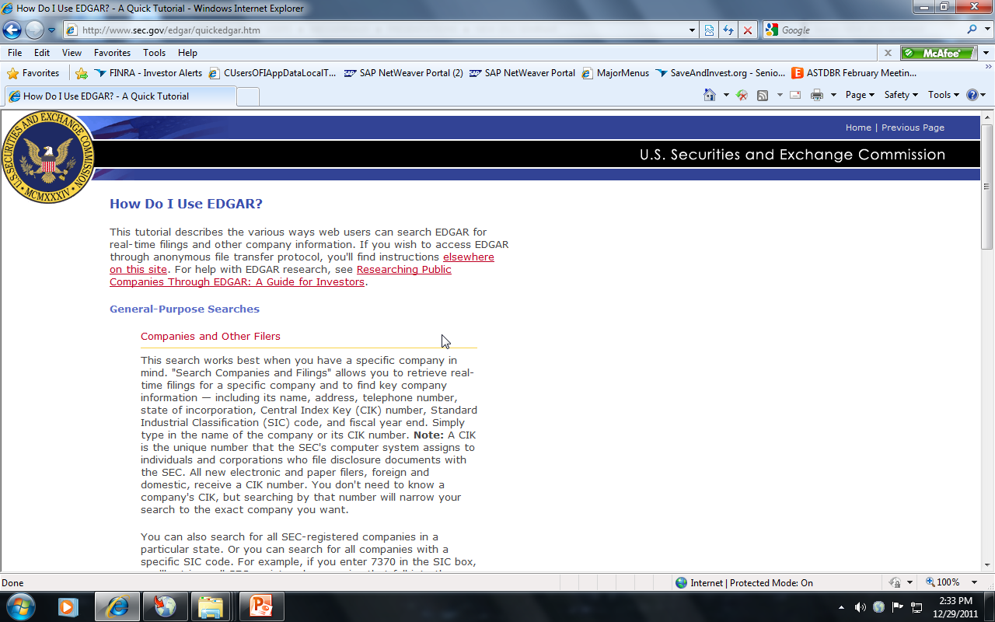
Search EDGAR on public offerings by:
Company or fund name, ticker symbol,
CIK (Central Index Key), file number, state, country or
SIC (Standard Industrial Classification)
Most recent filings
Full text (past 4 years)
Boolean and advanced search, including addresses
Key mutual fund disclosures
Mutual fund voting records
Mutual fund name, ticker or SEC key (since Feb. 2006)
Variable insurance products (since Feb. 2006)

Slide 21
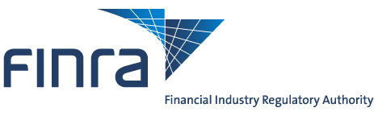
F
IN
R
A
inancial
dustry
egulatory
uthority
Wall Street’s self-policing organization, overseen by S.E.C.

Slide 22
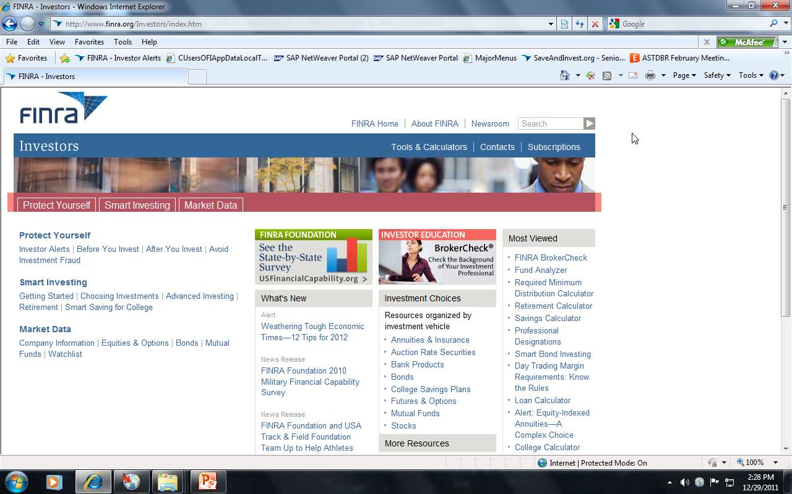
www.finra.org

Slide 23
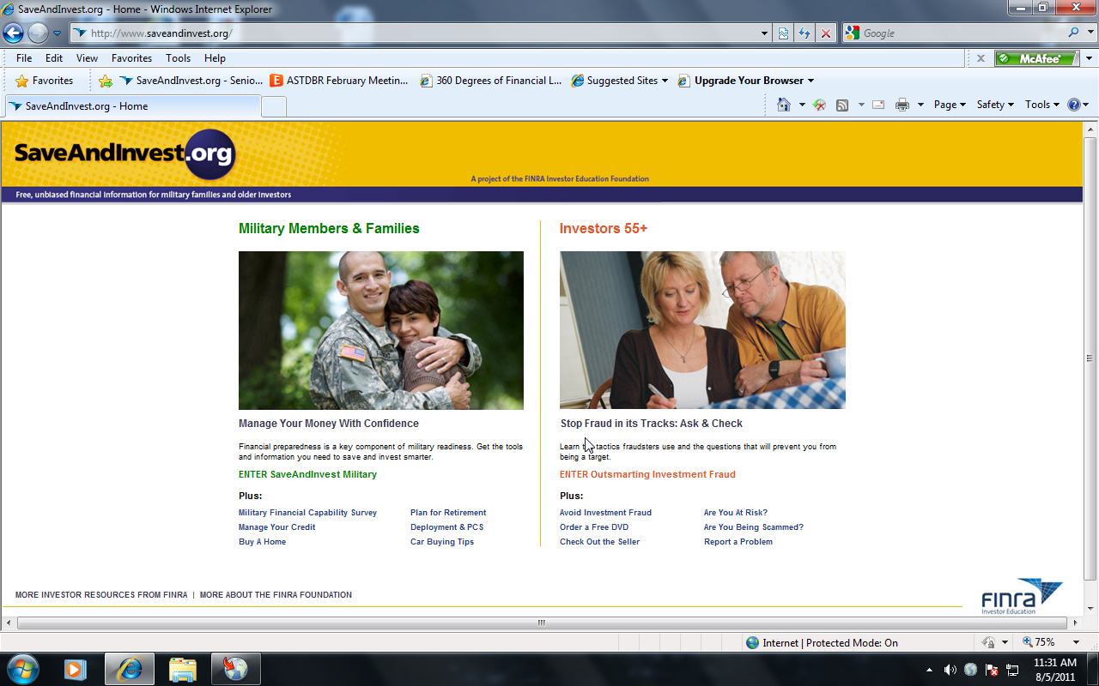
www.SaveAndInvest.org
Military
Investors 55+
Financial Capability Survey
Manage your credit
Buy a house
Plan for retirement
Car Buying Tips
Deployment & PCS
Outsmarting Investment Fraud
Avoid investment fraud
Are you at risk?
Are you being scammed?
Free DVD: Outsmarting Investment Fraud

Slide 24

Investor Basics

Slide 25

Encourage
business growth!
Protect
investors!
T-e-n-s-i-o-n
Less
regulation
More regulation

Slide 26
  *NASAA’s 2010 Enforcement Survey www.nasaa.org/regulatory-activity/enforcement-legal-activity/enforcement-statistics
Securities fraud is up 10%
1 in 3 enforcement actions involved senior citizens
Top 2 Sources of Fraud
  Unregistered individuals selling unregistered securities
Top 2 products of fraud
  Private offerings (Regulation “D”)
  Real estate investments or interests (especially distressed properties)

Slide 27
Top Products of Investment Fraud
TIME Moneyland, December 16, 2011
Financial Scams Target Boomers
Unregistered securities
  Promissory notes
  Private offerings
  Investment contracts
Non-traditional securities
  Gold mines
  Oil and gas wells
  Real estate

Slide 28

Investments sold in our state are legally required to be:
registered
OR
exempt from registration
Check with your state’s securities regulator to verify that the security you’re considering buying is registered or exempt from registration

Slide 29


Individual selling the product
There are Exemptions from registering
What is required to be “registered”?
The individual and the product sold are two separate things
Product (security) being sold
There are Exemptions from registering
Notes:
That depends on which category you’re discussing…think of the INDIVIDUAL selling the product as an apple, and the product being sold (security) as an ear of corn.

Slide 30
What’s “on record” with your state?
Call for details on Exemptions
Register with the state OR
No filing with the state required (exemption)
Individual
Product
(security)
Register with the state OR
Notice-file with the state OR
No filing with the state required (exemption)

Slide 31

Check out the Seller before investing
Send a written request for a FREE
C.R.D. Report
(Central Registration Depository)
    Certifications
    Pending arbitration
    Criminal history
    Employment History, including:
    Terminations
    Disciplinary Actions
    Customer Complaints

Slide 32
How To Request A CRD Report Form
C
R
D
an’t
emember
etails
For fastest service
Ask the investment professional for his/her
CRD Number or legal name
2. Email your request
Notes:
Reveals people with a “track record” (history of offenses)
Note: can take up to 4 months to post new information

Slide 33
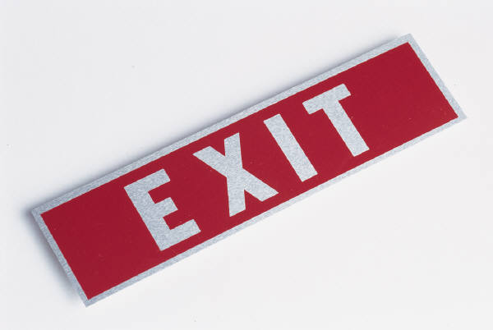
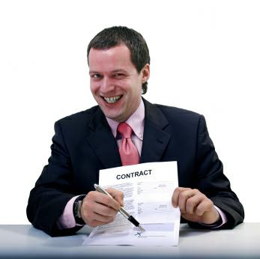
… out of the sales pitch

Slide 34
“Are you registered with the state to sell this security?”
NO
YES
Ask why not (may qualify for an exemption); take notes & offer to call back
Call your state securities regulator to check if the reason is legitimate
OR
to register a complaint
Ask for the person’s CRD Number or Legal name
Obtain and read a FREE CRD Report on the promoter before calling back

Slide 35
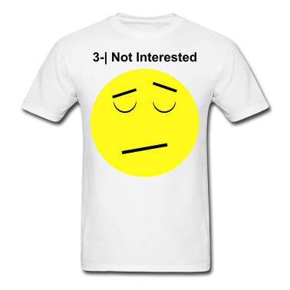
Rehearse a “Refusal Script”
“I never make financial decisions
without talking to my ____________”

Slide 36

Diversify!
Ask questions and check the answers
Check the registration (or exemption) of both the
product and the promoter with your state
securities regulator
NEVER rush into an investment
Get the deal in writing
“Guaranteed”? “Insured”?
Ask, “by whom?”
Obtain and read a CRD Report on your investment
professional before investing

Slide 37


